Slide 1
What is Financial Capability and asset building (FCAB)?

Slide 2
Module overview
Person-in-environment
Ability to act
Opportunity to act
Financial capability framework
Asset building
What we know from research
Summary

Slide 3
Person-in-environment
Financial policies
Financial services
Financial products
Individual’s knowledge and skills
Opportunity to act
Ability to act

Slide 4
Ability to act : Financial knowledge and skills
This is often known as financial literacy:
“. . . knowledge, skills, attitude, habits, motivation, confidence, and self-efficacy to make good financial decisions” (U.S. Government Accounting Office, 2011).
People gain knowledge and skills through socialization, experience, education, and guidance.

Slide 5
Opportunity to act : Financial access and inclusion
Financial access. Having access to and being empowered to use safe, affordable, and convenient financial products and services (Birkenmaier, Despard, Friedline, & Huang, 2019).
Financial inclusion, a broader term, also includes coverage by beneficial policies and consumer protections.
Knowledge and skills are insufficient to advance financial capability when financial access and inclusion are lacking (Sherraden & Huang, 2019).
For example, persistent structural barriers, such as racism and discrimination, often outweigh individuals’ knowledge and skills (and ability to act).

Slide 6
Putting it all together – Financial capability framework
Opportunity to Act:
Financial inclusion
Financial capability
Financial well-being
Ability to Act:
Financial knowledge and skills
(Johnson & Sherraden, 2007; Sherraden, 2013; Sherraden & Huang, 2018)

Slide 7
What is asset building?
Assets are the stock of wealth in a household.
Asset building refers to strategies that increase financial assets (savings, investments) and tangible assets (a home, a car).
Why assets?
Asset holding creates material conditions, outlooks, and behaviors that promote household development.
Owning assets “changes the way people think about their lives and future possibilities” (Sherraden, 1991, 2011).
“Assets are hope in concrete form.”
Sherraden, 1991

Slide 8
Asset building policies help people build assets... but not for everyone
Tax expenditures subsidize:
Homeownership
Retirement security
Savings and investment
Post-secondary education
Entrepreneurship.
Unfortunately, these tax expenditures overwhelmingly go to middle- and high-income households.
How Congress is Spending Billions to Make Wealth Inequality Worse

Slide 9
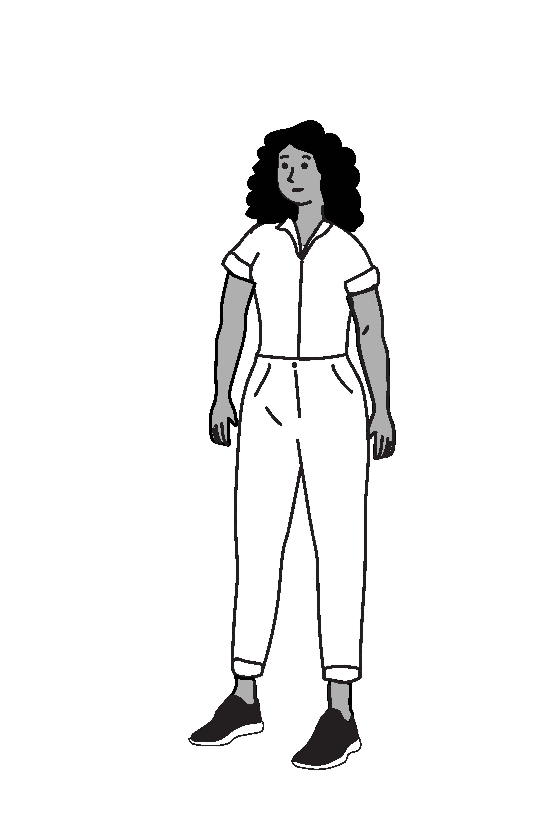
Case example: Introducing Tamika and Abey
These young women are similar:
Both are 16 years old
In high school
Good students
Taking a required financial education class
Their families and their communities are struggling financially
Their parents do not have bank accounts
Their families use alternative financial products and services
But the outlook for Tamika and Abey differ in important ways.

Slide 10
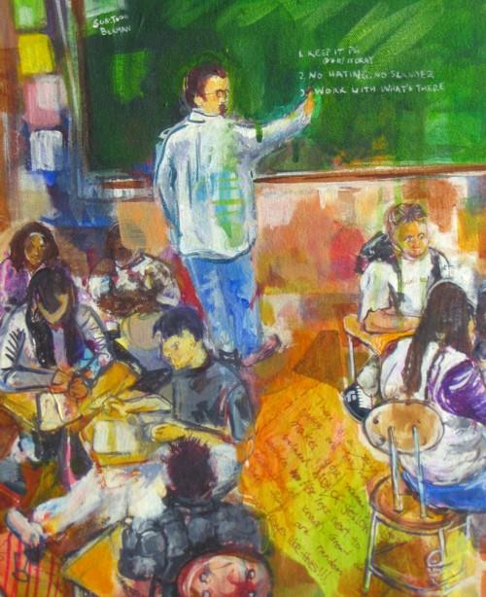
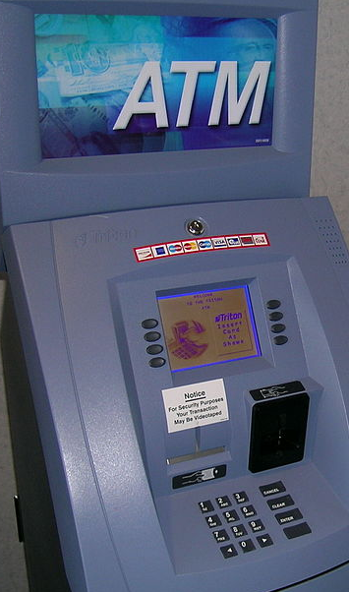
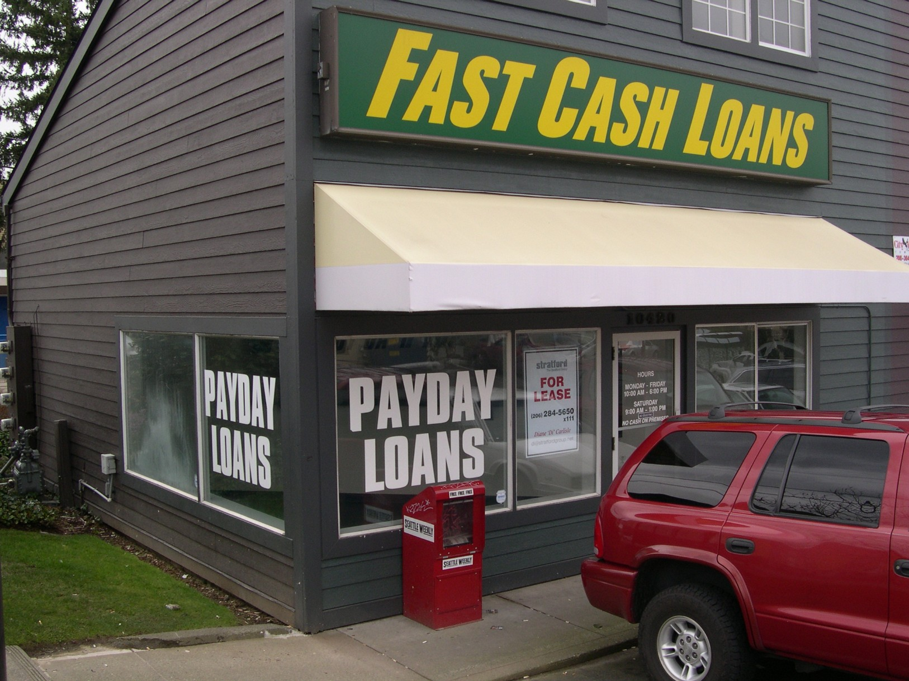
Tamika
©Todd Berman

Slide 11
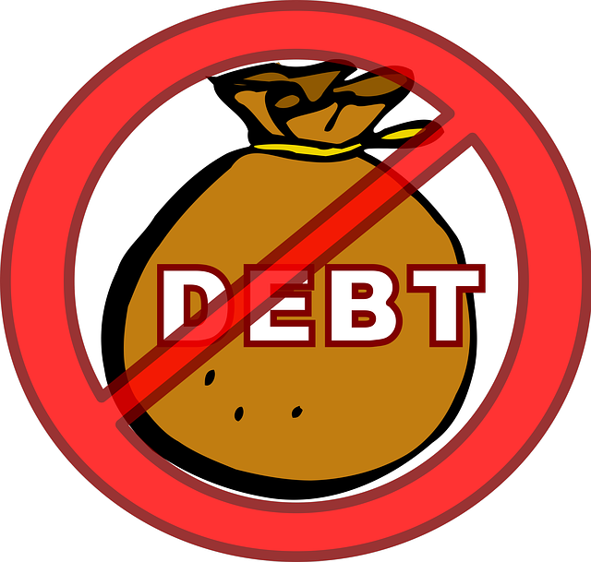
Abey

Slide 12
Different levels of financial capability
Tamika and Abey receive “A” grades in their financial education classes.
However, Abey is financially capable, and Tamika is not.
As these examples illustrate, the price of not having financial capability can be very high.
Tamika and Abey’s experiences are clearly the result of a different set of opportunities, not a lack of effort or talent!

Slide 13
Discussion: Encouraging financial capability and asset building
What are the possible structural factors that may have contributed to Tamika’s financial vulnerability?
How can we help Tamika and other young (and older) people build financial capability and assets?
Are there FCAB programs and services aimed at children and youth in your community? What about for adults and older adults?

Slide 14
Financial capability is a developmental process that occurs at every life stage
Develop numeracy
Adolescence
Keep financial records
Young Adulthood
Develop financial planning skills
Buy a car and insurance
Learn to use cash, piggy bank, and savings account
Understand wages and paycheck
Open a savings account
Obtain a credit card
Adulthood
Create spending plan/budget
Understand tax liabilities and tax benefits
Determine savings and investment goals
Plan and save for retirement
Buy a home
Older Adulthood
Understand retirement income
Manage spending and assets in retirement
Use Medicare, Social Security
Plan for disability, death
Childhood
Get a Social Security number
Obtain education loans
Receive prepaid debit cards as gifts
Receive a Child Development Account (CDA) at birth
Manage a financial account
Pay taxes, including FICA
Begin building credit
Apply for income supports
Develop wills and trusts
Save in retirement account

Slide 15
FCAB and social work practice: Improving people’s ability and opportunity to act
“Micro” Practice
“Macro” Practice
Work with clients and communities to improve financial knowledge and skills:
Assess client financial condition (Scanlon & Sanders 2017; Parker et al., 2016; CFPB, 2018)
Teach financial management (Lusardi et al., 2010)
Help clients:
Set and meet goals
Create spending plans
Resolve financial problems and conflicts (Klontz, Britt, & Archuleta, 2015; Nelson et al., 2015)
Generate income and enable asset accumulation
Develop and advocate for accessible, inclusive and progressive programs and policies for:
Income support (Lein et al., 2015)
Financial services (Friedline, Despard, & West, 2017)
Asset building (Sherraden et al., 2018)
Employment/business development (Sherraden & Sanders, 2010)
Financial education and counseling programs (Zhan et al., 2006)

Slide 16
Research on the building blocks of financial capability
Ability to act
Financial education
Financial guidance
Opportunity to act
Financial products and services
Financial policies and programs
Asset building policies and programs
Ability and opportunity to act
Combining financial education and financial services

Slide 17
What we know from research: Financial education
Financial education research examines effects on financial literacy and behaviors.
Experiential and participatory learning methods are particularly effective (CFPB, 2013; Kolb & Kolb, 2009).
Success factors include teacher preparation, rigorous program implementation, and relevant content (CFPB, 2019; Fernandes et al., 2014; Kasman et al., 2018; Lusardi, 2019; Urban, 2018).
Positive impacts on financial literacy and behavior depend on timing of financial education (“just in time”) (Kaiser & Menkhoff, 2017).
Experiments and standardized measures can better assess outcomes and true impacts of financial education (Fernandes et al., 2014; Kaiser & Menkhoff, 2017; Miller et al., 2014).

Slide 18
What we know from research: Financial education in schools
As of 2020, 21 states required high school students to take a course in personal finance (Council for Economic Education, 2020).
Some studies indicate improved credit management, higher credit scores, and lower use of payday loans (Urban, 2018; Harvey, 2019).
Variations in the ways that states implement high school personal finance education policies can affect learning outcomes (Urban, 2018).

Slide 19
What we know from research: Financial guidance
Financial guidance/mentoring can substitute for lack of family modeling (Collins & O-Rourke, 2009).
Credit issues often drive requests for guidance (Theodos et al., 2015).
Financial coaching can reduce debt, increase savings, and improve money management and sense of financial well-being (Theodos et al., 2015).
In one year, financial empowerment services in 5 cities reduced $5.5 million debt and $750,000 household savings for 8,000 people (Mintz, 2014).
Financial guidelines, text messages, and deposit reminders can improve financial outcomes (CFPB, 2017; Rodriguez & Saavedra, 2019).

Slide 20
What we know from research: Financial products and services
People who do not own bank accounts use often costly and risky alternate financial services (Council of Economic Advisors, 2016; Office of the Inspector General, US Postal Service, 2014).
Access to safe and affordable products/services enables people to safely manage household resources, and accumulate assets (Barr & Blank, 2009).
More mainstream financial institutions offer innovations, such as Bank On, small dollar loans, and mobile services (Erwitt, Plat, Bradley, Diner, & Covington, 2018; FDIC, 2009; Tescher, 2019).
FinTech offers cost-effective non-bank products, such as mobile wallet, payment cards (PwC, 2016; Reilly, 2019).

Slide 21
What we know from research: Financial capability policies and programs
Federal matched savings program increased savings, reduced use of check-cashing services and material hardship, and improved perception of financial security (Mills et al., 2016).
CARD Act of 2009 protects consumers from abusive lending practices, reduces credit card costs, and increases fee transparency (CFPB, 2015).
Policies, such as the Dodd Frank Act 2010, allow CFPB to provide financial protections (e.g., settled with Equifax and TransUnion to pay $17.6 million to harmed consumers; CFPB, 2017).

Slide 22
What we know from research: Asset-building policies and programs
A savings account in a child’s name is associated with college attendance and completion (Elliott & Beverly, 2011).
Child Development Accounts (CDAs) facilitate access and reduce asset inequality (Clancy, Sherraden, & Beverly, 2019).
CDAs positively impact mother’s mental health, educational expectations of child, and child development, especially for low-income families (Huang et al., 2019).

Slide 23
What we know from research: Combining financial education and services
$
In-school banking, which combines financial education and a savings account, increases account opening and saving (Lee et al., 2017 ; Sherraden et al, 2009; Weidrich et al., 2014).
In Native American communities, integrating financial education with use of financial products and services increases credit scores and savings rates (Langholz, 2014).
Intimate partner violence programs increase client financial independence by combining financial education and access to financial products (Sanders & Schnabel, 2004; Sanders, 2010).

Slide 24
Summary of what we learned
Financial capability builds on social work’s person-in-environment perspective.
Financial capability combines:
the ability to act through financial literacy, and
the opportunity to act through financial inclusion.
Building assets is the accumulation of financial and tangible assets (homes, investments). In some contexts, assets may be held by communities.
Research is developing a knowledge base about the effects and importance of combining the ability and opportunity to act.

Slide 25
Thank you to our funders:
Equifax Foundation
The Arthur Vining Davis Foundations
Wells Fargo Advisors
Image Credits
“Forlease” By A Mclin Is Licensed Under CC BY 2.0
“Atm At The Secretary Of State In Portage, Mi” By Nenyedi Is Licensed Under Cc By-sa 3.0 Via Wikimedia Commons
Todd Berman, Http://Www.Theartdontstop.Org/Show_topic.Php?Id=10034
“Basket Of Eggs” By 401(K) 2012 Is Licensed Under CC BY-SA 2.0
"Mortgage Rates" by MarkMoz12 is licensed under CC BY 2.0
“Jar Of Money” By Steve Depolo Is Licensed Under CC BY 2.0
“debt-37557_640” is licensed under CC0 1.0
“College” by 401(K) 2012 is licensed under CC BY-SA 2.0
“WA-529” is licensed under CC BY-SA 3.0 via Wikimedia Commons
“Success road sign” by Keith Ramsey (RambergMediaImages) is licensed under CC BY-SA 2.0
School png by KindPNG: https://www.kindpng.com/imgv/TTwoT_school-png-pic-transparent-background-school-clipart-png/

Slide 26
Contact Information
FCAB Initiative
Center for Social Development
Brown School of Social Work
Washington University in St. Louis
https://csd.wustl.edu

