Slide 1


FCAB and the role of social work
Copyright © 2020 Center or Social Development; July 2021

Slide 2
Module overview
The historical roots of FCAB in social work
Social work and FCAB practice
Financial capability and health
Person-in-environment and FCAB
Four families
“The good we secure for ourselves is precarious and uncertain, is floating in mid-air, until it is secured for all of us and incorporated into our common life.”
– Jane Addams, Twenty Years at Hull House, 1912

Slide 3
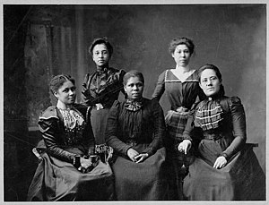
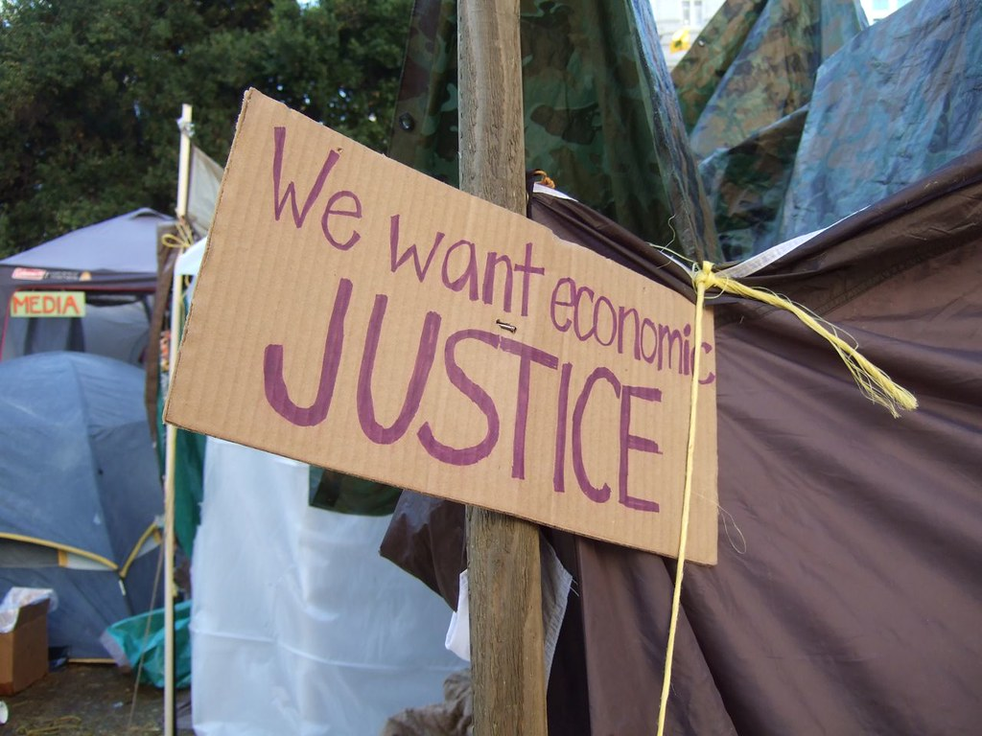
Social work and financial well-being in historical perspective
The “family budget” was central to social work practice in the Progressive Era (Stuart, 2013).
Social workers were key players in developing income support and employment policies during the New Deal.
By mid-20th century, however, the profession’s focus shifted to psychosocial functioning (Specht & Courtney, 1994).
But financial issues and economic justice moved back to center stage by the turn of the 21st century.

Slide 4
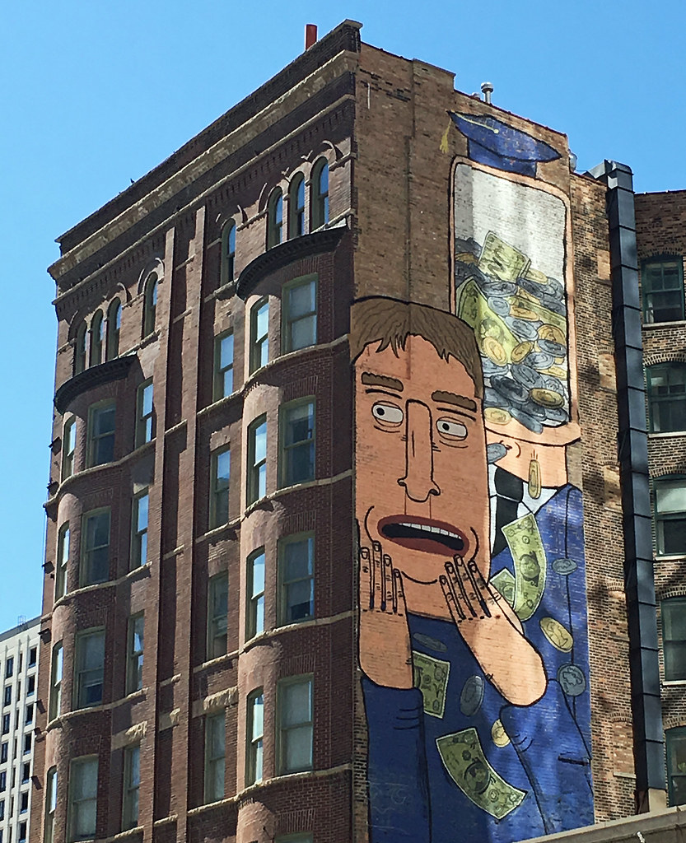
Financial vulnerability and inequality are deepening
Growing inequality in the aftermath of one recession and in the midst of another was intensified by a pandemic.
Nearly half of households in 2020 report “serious financial problems.” (NPR/RWJF/Harvard, 2020)
Financial vulnerability is disproportionately affecting families of color, whose median income and net worth are far below white families. (Dettling, et al. 2017, Wilson & Williams 2019)

Slide 5
Today, finances are the top source of stress in U.S. households
#1
$tre$$ors
The top two personal stressors are money and work. (American Psychological Association, 2019)
The negative effects of financial problems intensify when financial hardship persists and in contexts of economic inequality. (Emerson, 2009; Kahn & Pearlin, 2006; Sapolsky, 2005)
Money and Work

Slide 6

A renewed commitment to financial practice and economic justice
Social workers know that finances are central to well-being:
Financial problems contribute to emotional distress and health problems. (Deaton, 2012; Dowd et al., 2011; Chetty et al., 2016; Purnell, 2015; Taylor, et al., 2009)
Poor health, addiction, and other mental health disorders also can magnify financial difficulties.
Notes:
"The Hand" by Alex E. Proimos is licensed under CC BY-NC 2.0

Slide 7

Social workers confront issues of financial vulnerability every day
Financial vulnerability frequently accompanies—or is at the heart of—issues that social workers confront every day working with people who experience:
mental illness and substance abuse
domestic violence
child abuse and neglect
poor health
homelessness
immigration
Though social workers often lack financial knowledge, skills and confidence to help vulnerable families with their financial troubles, they can help.

Slide 8

Social Workers Bring Unique Perspectives and Skills to Financial Practice

Slide 9


Social workers are first and foremost focused on enhancing well-being
The Social Work Code of Ethics focuses on enhancing human well-being, particularly for those who are vulnerable, oppressed, and living in poverty (NASW, 2020).
Guiding principles of FCAB:
  Use a strengths perspective
  Start where the client is
  Maintain a nonjudgmental attitude
  Uphold self-determination
  Exercise cultural competence and humility
  Ensure inclusion and fairness
  Promote progressive policies

Slide 10

Social work’s person-in-environment approach is essential to advance financial well-being
Social workers focus on “people in their environment.” (Kondrat, 2013)
They recognize that financial troubles are not the “fault” of individuals.
They are rooted in social structures that create and maintain financial vulnerability and poverty.
Social workers work with clients (micro-level practice), improve conditions in organizations and communities (mezzo-level practice), and create better policies (macro-level practice) to advance financial capability.

Slide 11

Micro level
Social workers solve problems with individuals and families who are financially vulnerable:
  Address mental health or addiction issues that may worsen financial problems (and vice versa).
  Identify and connect families to resources to meet basic needs (e.g., food, housing, health care).
  Build financial understanding by educating and guiding about budgeting and credit building.
  Help families plan for the future.
  Address cultural barriers to using financial services.

Slide 12

Mezzo and macro levels
Social workers promote policies, programs, and services that benefit financially vulnerable groups in collaboration with organizations and coalitions, such as:
  Social service organizations
  Health and mental health organizations
  Community development and housing organizations
  Financial empowerment groups
  Equally important, social workers empower people to advocate for change on their own behalf.

Slide 13
Exercise:
Examples of clients with financial challenges
A survivor of intimate partner violence (IPV) has bills she can’t cover
A client is transitioning from prison and has absolutely no money
Youth emerging from foster care with no money management experience
Immigrants who are doubled up and tripled up in housing during the COVID-19 pandemic
A couple with serious money conflicts
Parents of children living with disabilities who are worried about their financial future
Migrant farmers who run out of money during the off-season
Older adults with cognitive decline
Entire communities who lack access to bank branches
What can a social worker do?

Slide 14
Exercise (continued):
Some initial ideas
A survivor of IPV: Assistance to help her decide which debts to pay first. . .
People transitioning from prison: Help enroll them in a financial empowerment program. . .
Youth leaving foster care: Open a savings account and provide financial education. . .
Immigrants: Help them find housing, organize a coalition to demand better housing. . .
Couple with money conflicts: Provide financial counseling/therapy. . .
Parent of people living with disabilities: Help them enroll their children in ABLE Accounts. . .
Migrant farmers: Financial counseling to plan for seasonal income, promote policy to support farmworkers. . .
Poor cognition, older adults: Ensure they have enrolled in Social Security and Medicare. . .
Communities without financial services: Start a BankOn coalition. . .

Slide 15
Introducing the Families
Four families whose financial troubles are Creating hardship and Preventing them from achieving their goals

Slide 16
Case examples: George and Yolanda
George Williams lives on the Blackfeet Reservation, has a low income from his human services job, and is having trouble making ends meet. Ten years ago, he filed for bankruptcy. He wants to avoid this again at all costs. He’s trying to get a college degree to improve his financial situation.
Yolanda Walker is an African-American certified nurse assistant. She gets by, but worries about her medical debt, her mother whose cognition is failing, and her daughter who is a single mom. She’s exhausted, wondering if she will ever be able to retire.

Slide 17
Case examples: Jewell and Silvia & Hector
Jewell Murray is learning how to manage her finances after finally leaving her violent and abusive husband. She is feeling like there’s so much to learn, and she worries about her young daughter who has special needs.
Silvia Hidalgo Acevedo and Hector Contreras Espinosa want to buy a house for their multi-generational family, but a financial scam sets them back. Meanwhile, they are worried about Silvia’s little sister, who came from Mexico to live with them, is in the country without legal documents.

Slide 18
Summary of what we learned
Social workers are uniquely qualified and play an important role in helping families build financial capability:
  Address financial troubles of US families and rising economic and racial/ethnic inequality.
  Build on the discipline’s historical commitment to improving people’s financial well-being and future opportunities.
FCAB - an opportunity for social workers to expand their policy, practice, and research tool box.
Which insurance to buy?
Help making ends meet
Paying taxes
How to talk
about money
Saving for the future
Policies for economic & racial/ethnic equality
Borrowing safely
Managing student debt
Advocate for safe and effective financial services
Developing credit building programs
Coping with
financial emergencies
Opening a
bank account

Slide 19
Image Credits
Slide 3: 5_female_Negro_officers_of_Women_League,_Newport,_R.I_LCCN2001705854.jpg, Library of Congress's Prints and Photographs division under the digital ID cph.3a51595,; "We Want Economic Justice" by Earthworm is licensed under CC BY-NC-SA 2.0
Slide 4: "Financial Stress by Don't Fret" by wiredforlego is licensed under CC BY-NC 2.0
Slide 6: "The Hand" by Alex E. Proimos is licensed under CC BY-NC 2.0
Slide 7: https://theconversation.com/income-inequality-may-be-declining-but-financial-vulnerability-is-increasing-84053
Slide 8: "World Day for Social Justice" by rikkis_refuge is licensed under CC BY 2.0
Slide 9 : https://www.socialworkers.org/about/ethics/code-of-ethics/code-of-ethics-english ; https://www.naswpress.org/search/code_of_ethics_spanish
Slide 10: "Multiethnic look" by marcobolzan is licensed under CC BY-NC-ND 2.0
Slide 11: "Social Workers" by Timothy Valentine is licensed under CC BY-NC-SA 2.0
Slide 12: Grand Challenges for Social Work. Capitol photo courtesy of the architect of the capitol

Slide 20
Thank you to our funders:
Equifax Foundation
The Arthur Vining Davis Foundations
Wells Fargo Advisors

Slide 21
Contact Information
FCAB Initiative
Center for Social Development
Brown School of Social Work
Washington University in St. Louis
https://csd.wustl.edu
Copyright © 2020 Center for Social Development

