Slide 1
Focus on Native Communities
A complementary resource to Your Money, Your Goals
Notes:
This PowerPoint presentation is designed to help you train frontline staff and volunteers on using Focus on Native Communities with the people they serve.
Because Focus on Native Communities is a resource that is designed to be used in combination with the Your Money, Your Goals toolkit, we recommend combining this presentation with selected slides from the main Your Money, Your Goals presentation found at a link on the Your Money, Your Goals training web page: https://s3.amazonaws.com/files.consumerfinance.gov/f/documents/20170201_YMYG_training_slides.pptx.
To do so:
Review the Your Money, Your Goals toolkit for tools and information that you would like to cover in your training.
Review the main Your Money, Your Goals presentation for activities that will make your training interactive and help you achieve your objectives for the training.
Copy and paste the relevant slides from Steps 1 and 2 from the main Your Money, Your Goals presentation into this presentation, placing them where they fit best given the other topics you are covering.
The resulting presentation will allow you to cover tools and information from both Focus on Native Communities and the Your Money, Your Goals toolkit.
Be sure to distribute hard copies of both Focus on Native Communities and the Your Money, Your Goals toolkit. You can distribute complete copies or excerpts based on your objectives for the training. The full suite of Your Money, Your Goals materials is available at https://www.consumerfinance.gov/your-money-your-goals, and that page includes an order form for hard copies of some materials.

Slide 2
DISCLAIMER
This presentation is being made by a Consumer Financial Protection Bureau representative on behalf of the Bureau. It does not constitute legal interpretation, guidance or advice of the Consumer Financial Protection Bureau. Any opinions or views stated by the presenter are the presenter’s own and may not represent the Bureau’s views.
This document includes links or references to third-party resources. The inclusion of links or references to third-party sites does not necessarily reflect the Bureau’s endorsement of the third-party, the views expressed on the third-party site, or products or services offered on the third-party site. The Bureau has not vetted these third-parties, their content, or any products or services they may offer. There may be other possible entities or resources that are not listed that may also serve your needs.

Slide 3
Training purpose
To provide you with:
Information and tools to meaningfully connect Your Money, Your Goals to the community members you serve and help them manage or address their financial challenges
An orientation to Your Money, Your Goals and Focus on Native Communities
The knowledge and confidence to use the information and tools in your community
Notes:
ACTIVITY #1: Overview of the Training and Introductions
Estimated Time: 10 Minutes
Methodology: Presentation / Icebreaker (Introduction Activity)
Corresponding Section in Toolkit: None
Instructions for Facilitator:
Review training purpose.

Slide 4
Training objectives
Understand the content of Focus on Native Communities
Be able to identify moments in which you could introduce the tools to the people you serve
Be able to use its tools to help people take steps to reach their financial goals
Understand how this resource complements the information and tools in the Your Money, Your Goals toolkit
Notes:
ACTIVITY #1: Overview of the Training and Introductions CONTINUED
Presentation
Explain that the purpose of the training is like the mission—overall what the training is trying to do.
Explain that objectives are the specific things they will know or be able to do as a result of the training.
Review objectives. Be sure to paraphrase, not read.

Slide 5
Introductions
Share the following:
Your name
Your organization or affiliation
Your interest in financial empowerment
Notes:
ACTIVITY #1: Overview of the Training and Introductions CONTINUED
Icebreaker
Invite participants to introduce themselves to the full group by sharing their name, organization or affiliation, and interest in financial empowerment.

Slide 6
Focus on Native Communities

Slide 7
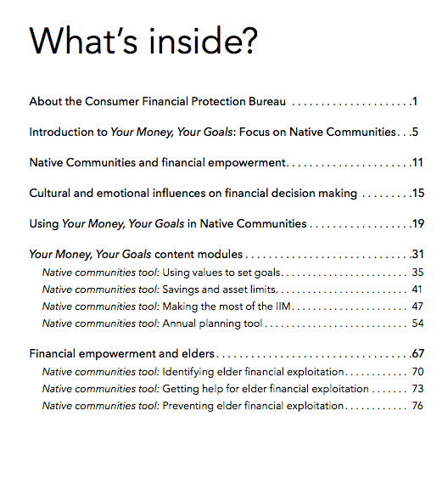
Focus on Native Communities
Notes:
ACTIVITY #2: Focus on Native Communities
Estimated Time: 30 - 45 Minutes
Methodology: Presentation / Table-based Discussion / Exercise in Pairs with Report Out
Corresponding Sections: Introduction to Your Money, Your Goals: Focus on Native Communities (page 5), Native Communities and financial empowerment (page 11) from Focus on Native Communities, and Using Your Money, Your Goals in Native Communities (page 19)
May also be useful to refer to the table of contents of Your Money, Your Goals
Presentation
Explain that Your Money, Your Goals: Focus on Native Communities—contains additional information, tips, and tools based on the wisdom of tribal staff and organizations that serve Native Communities. Its goal is to meaningfully connect the content and tools in Your Money, Your Goals to the Native Communities in which you live and work.
Explain that in early 2016, representatives from the following tribes and organizations gathered to reflect on the experiences these leaders had in sharing the toolkit and on ways to share additional information that could assist other Native Communities in implementing Your Money, Your Goals:
Citizen Potawatomi Nation Chippewa Cree Tribe Confederated Tribes of the Colville reservation Sault Ste. Marie Tribe of Chippewa Indians Seminole Tribe of Florida Office of the Special Trustee
The American Indian Center at the University of North Carolina at Chapel Hill
Review the general contents using the table of contents.

Slide 8
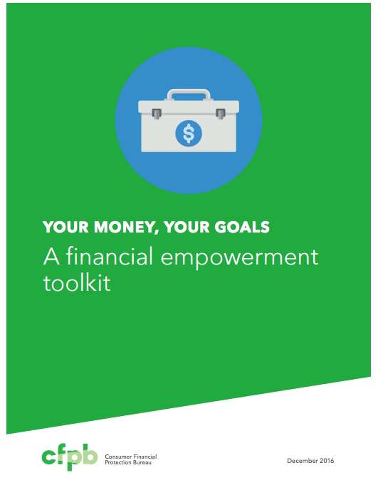
Your Money, Your Goals resources
Your Money, Your Goals Toolkit
Your Money, Your Goals Training
Implementation guide
Focus on Reentry
Focus on Persons with Disabilities
Behind on bills?
Notes:
ACTIVITY #2: Focus on Native Communities CONTINUED
Presentation
Explain that Focus on Native Communities was designed to be use in conjunction with Your Money, Your Goals Toolkit and other resources.
Explain that all materials are available for download online, free-of-charge.
Explain that all materials are not copyrighted.

Slide 9
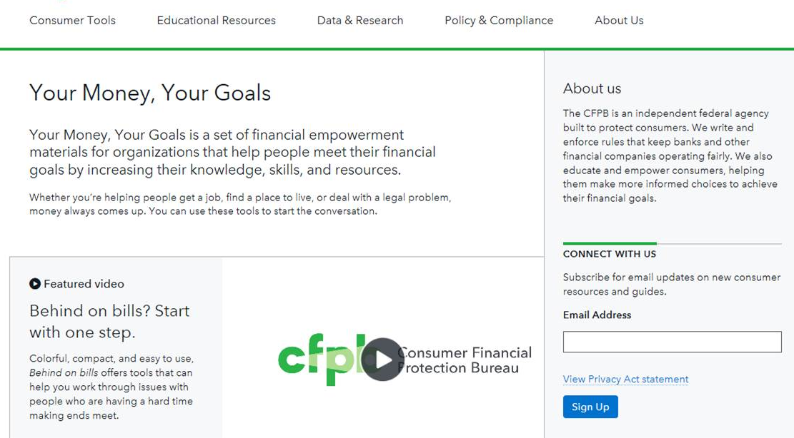
Your Money, Your Goals
Notes:
ACTIVITY #2: Focus on Native Communities CONTINUED
Presentation
Explain that Your Money, Your Goals is a financial empowerment toolkit consisting of modules staff and volunteers can integrate into the work they do each day with their clients.
Explain that modules function independently of one another, can be used in any combination, and are appropriate for a wide variety of client populations, as well as case managers and social workers who may benefit from financial empowerment in their own lives.
Explain that this is where all of the Your Money, Your Goals resources including Focus on Native Communities can be found at the Your Money, Your Goals landing page on the CFPB’s website.

Slide 10
Your Money, Your Goals and Focus on Native Communities
These resources serve:
Case managers, frontline staff, and volunteers in tribal social services or other non profit and government agencies that want to:
Help financially empower the people they serve
Strengthen their own financial knowledge and skill
Community members that may want or need financial empowerment information, skill-building opportunities, and tools
Notes:
ACTIVITY #2: Focus on Native Communities CONTINUED
Presentation
Explain the two audiences the toolkit and Focus on Native Communities was designed to serve:
Case managers, frontline staff, and volunteers in tribal social services or other nonprofit and government agencies that want to:
Help financially empower the people they serve.
Strengthen their own financial knowledge and skill.
Community members that may want or need financial empowerment information, skill-building opportunities, and tools to solve their immediate challenges or reach their goals.

Slide 11
Benefits of Your Money, Your Goals
Your Money, Your Goals may benefit individuals and families in your community by helping them:
Set goals based on their values.
Make plans to reach their goals.
Use cash flow to cover living expenses today and plan for the future.
Get rid of debt.
Notes:
ACTIVITY #2: Focus on Native Communities CONTINUED
Presentation
Review the benefits of Your Money, Your Goals and Focus on Native Communities.

Slide 12
Benefits of Your Money, Your Goals
Your Money, Your Goals may benefit individuals and families in your community by helping them:
Review credit reports and fix errors.
Choose the right financial products and services to meet their needs.
Recognize their consumer rights, how to protect them, and what to do if they have been violated.
Protect elders from financial exploitation.
Notes:
ACTIVITY #2: Focus on Native Communities CONTINUED
Presentation
Review the benefits of Your Money, Your Goals and Focus on Native Communities.

Slide 13
Benefits of Your Money, Your Goals
Community members are able to:
Take care of their financial needs and obligations and contribute to the community.
Make informed decisions about protecting and growing community assets.
Make informed decisions about balancing today’s needs while planning for the next generation.
Notes:
ACTIVITY #2: Focus on Native Communities CONTINUED
Presentation
Review the benefits of Your Money, Your Goals and Focus on Native Communities.

Slide 14
Organization of Your Money, Your Goals
Introductory modules
Introduction Part 1: Introduction to the toolkit
Introduction Part 2: Understanding the situation
Introduction Part 3: Starting the money conversation
Introduction Part 4: Emotions, values, and culture: What’s behind our money choices?
Notes:
ACTIVITY #2: Focus on Native Communities CONTINUED
Presentation
Review organization of the toolkit using slide. Explain that the toolkit has introductory modules.
Review the purpose of the toolkit: The goal of Your Money, Your Goals is to improve client outcomes by making it easier for you as a case manager to help clients become more financially empowered.

Slide 15
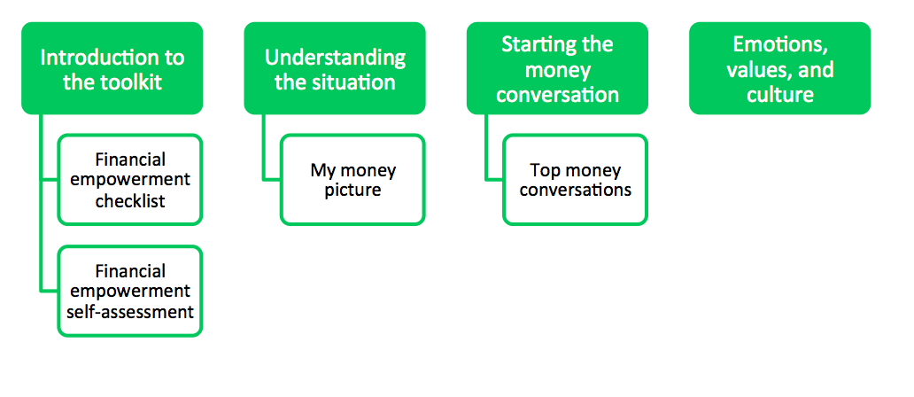
Organization of Introduction to Your Money, Your Goals
Introductory modules
Introduction Part 1: Introduction to the toolkit
Introduction Part 2: Understanding the situation
Introduction Part 3: Starting the money conversation
Introduction Part 4: Emotions, values, and culture: What’s behind our money choices?
Notes:
ACTIVITY #2: Focus on Native Communities CONTINUED
Presentation
Show how each section of the toolkit has tools within it. For example, in the Introduction to the toolkit there are two tools: Financial empowerment checklist and financial empowerment self-assessment.
Explain that these tools are not repeated in Focus on Native Communities. You can use these tools as well as the new tools in Focus on Native Communities.

Slide 16
Organization of Your Money, Your Goals
Content modules
Module 1: Setting goals and planning for large purchases
Module 2: Saving for the emergencies, bills, and goals
Module 3: Tracking and managing income and benefits
Module 4: Paying bills and other expenses
Module 5: Getting through the month
Module 6: Dealing with debt
Module 7: Understanding credit reports and scores
Module 8: Money services, cards, accounts, and loans: Finding what works for you
Module 9: Protecting your money
Notes:
ACTIVITY #2: Focus on Native Communities CONTINUED
Presentation
Review the content modules.

Slide 17
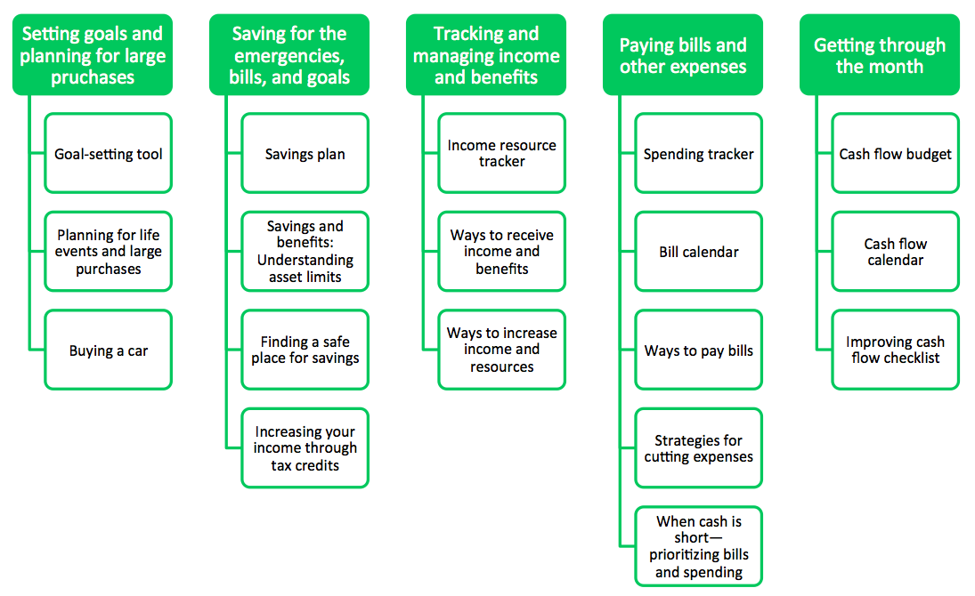
Organization of Your Money, Your Goals
Content modules
Module 1: Setting goals and planning for large purchases
Module 2: Saving for the emergencies, bills, and goals
Module 3: Tracking and managing income and benefits
Module 4: Paying bills and other expenses
Module 5: Getting through the month
Module 6: Dealing with debt
Module 7: Understanding credit reports and scores
Module 8: Money services, cards, accounts, and loans: Finding what works for you
Module 9: Protecting your money
Notes:
ACTIVITY #2: Focus on Native Communities CONTINUED
Presentation
Explain that this shows each content module with the tools are that included in the module.

Slide 18
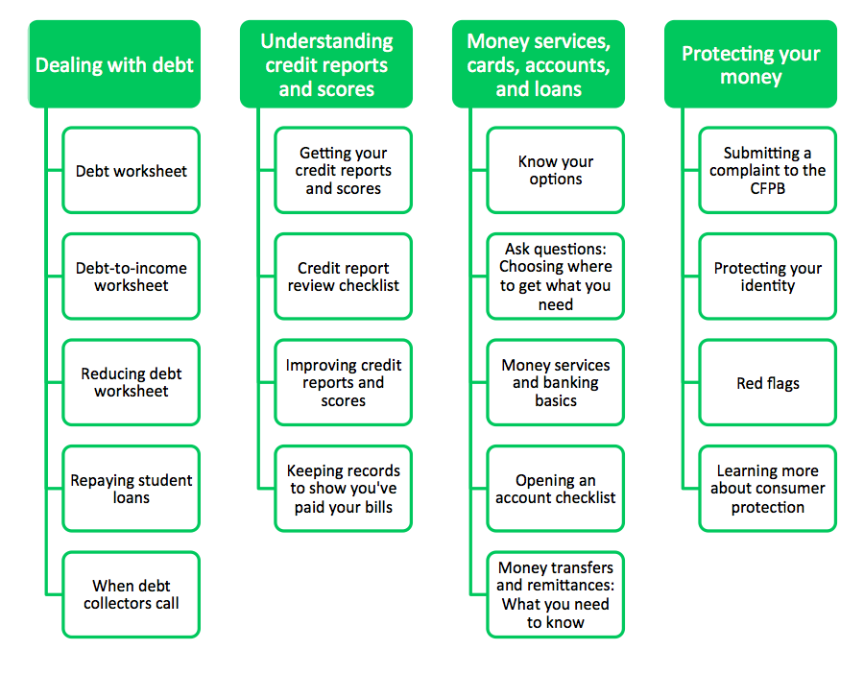
Organization of Your Money, Your Goals
Notes:
ACTIVITY #2: Focus on Native Communities CONTINUED
Presentation
Explain that this shows each content module with the tools are that included in the module.
Explain that dealing with debt is important in Native Communities. The tools associated with debt are NOT in Focus on Native Communities, but they can be easily referenced in Your Money, Your Goals. Ideally, both resources are used together.
Explain the key elements of a Toolkit and how the Toolkit is different from a curriculum:
Do not treat the Toolkit like a curriculum—the goal is not to get through all of the materials when working one-on-one with a client or to cover the material and tools in order.
Provide the right content and tools at the right time.
Use discussions with clients or assessments to figure out where to start.

Slide 19
Focus on Native Communities companion guide contents
About the Consumer Financial Protection Bureau
Introduction
Native Communities and financial empowerment
Cultural and emotional influences on financial decision making
Using Your Money, Your Goals in Native Communities
Your Money, Your Goals content modules
Native Communities tool: Using values to set goals
Native Communities tool: Savings and asset limits
Native Communities tool: Making the most of the IIM
Native Communities tool: Annual planning tool
Notes:
ACTIVITY #2: Focus on Native Communities CONTINUED
Presentation
Review the general contents using the table of contents (which continues onto the next slide).
Note that the tools listed here and on the next slide are designed to be used in addition to the set of tools already found in the Your Money, Your Goals toolkit. In addition to the new tools, Focus on Native Communities provides information on financial topics in a way that is relevant to the lives of people in Native Communities.

Slide 20
Focus on Native Communities companion guide contents, continued
Financial empowerment and elders
Native Communities tool: Identifying elder financial exploitation
Native Communities tool: Getting help for elder financial exploitation
Native Communities tool: Preventing elder financial exploitation
Notes:
ACTIVITY #2: Focus on Native Communities CONTINUED
Presentation
Financial empowerment and elders is a supplemental module containing both information and tools on this important topic.
Table-based discussion
ASK: Given what you have seen so far, how could you envision using Your Money, Your Goals?
Instruct groups to be prepared to report what they have discussed.
Write their ideas on flip chart paper or white board.
Share ways to use Your Money, Your Goals and Focus on Native Communities in one-on-one and group settings.

Slide 21
Using Your Money, Your Goals and Focus on Native Communities—One-on-one
A tribal social service staff member providing case management to individuals in the community.
An elder mentoring a young adult in the community.
A Native Community Development Financial Institution (CDFI) staff member providing additional financial information and skill building to a prospective small business owner.
A financial coach helping a community member reach her goals.
Notes:
ACTIVITY #2: Focus on Native Communities CONTINUED
Summary of Small Group Reports
Summarize ideas based on group report outs.

Slide 22
Using Your Money, Your Goals and Focus on Native Communities—Group settings
Community or organizational meetings
Brown bag lunches or a lunch-and-learn series
Other community training events
Tribal gatherings
Notes:
ACTIVITY #2: Focus on Native Communities CONTINUED
Summary of Small Group Reports
Summarize ideas based on group report outs.

Slide 23
Integrating Your Money, Your Goals
The strongest integration strategies start with the end user in mind:
Who will be using the toolkit?
How will they use the toolkit?
What outcomes do you want to achieve through the use of the toolkit? (Outcomes are results that bring about changes or benefits)
What content in the toolkit is most important to achieving these outcomes?
Notes:
ACTIVITY #2: Focus on Native Communities CONTINUED
Exercise (pairs)
Have teams of two work through these questions together.
Give teams 5 – 10 minutes to work through this.
Have a subset of the groups report out. Try to select diverse examples.
Thank participants for their contributions.
Explain that now that they have an overview of Your Money, Your Goals and Focus on Native Communities, the rest of the training will focus on content and tools.

Slide 24
Your Money, Your Goals
Implementing Your Money, Your Goals and Focus on Native Communities

Slide 25
Module 1: Setting goals and planning for large purchases
Specific
Measurable
Able to be reached
Relevant
Time-framed
Goals can be the foundation for building greater self- determination. They provide direction for how to use resources including money.
Notes:
Activity #3: Implementing Your Money, Your Goals and Focus on Native Communities
Estimated Time: 60 – 90 Minutes
Methodology: Various methodology
Corresponding Sections: Content Modules of Focus on Native Communities starting on page 31
Presentation
Encourage participants to follow along in Module 1 in Focus on Native Communities on page 31.
Explain the qualities of strong goals using the following:
Specific
When setting a goal, ask yourself the questions: Who? What? Why?
A specific goal has a much greater chance of being met than a general goal.
Measurable
You should be able to track your progress toward meeting the goal.
Ask yourself questions like: How much? How many? How will I know when it is done?
Able to be reached
Is this goal something that you can actually reach?
You might want to get rid of credit card debt tomorrow or become a millionaire in a year, but for most of us, that's a totally impossible goal!
That doesn't mean that your goals should be easy. Your goal may be a stretch for you, but it should not be extreme or impossible.
Relevant
Set goals that matter to you and are a priority in your life.
Ask yourself the questions: Is this something that I really want? Is now the right time to do this?
Time-framed
Goals should have a clearly defined time frame, including a target or deadline date.
Explain the significance or relevance of goal-setting to Native Communities using quote on the slide:

Slide 26
Module 1: Setting goals and planning for large purchases
Use Tool 1: Goal-setting tool to set SMART goals, make plans, and figure out weekly savings target.
Use Tool 2: Planning for life events and large purchases to anticipate and plan for the expenses associated with these.
Use Tool 3: Buying a car to discuss key considerations before buying a car.
Native Communities Tool: Using values to set goals was developed for use in Native Communities to supplement these tools.
Notes:
Activity #3: Implementing Your Money, Your Goals and Focus on Native Communities CONTINUED
Presentation
Review highlights of the three tools in referenced Module 1 and transition to the Native Communities tool.

Slide 27
Native Communities Tool: Using values to set goals
Notes:
Activity #3: Implementing Your Money, Your Goals and Focus on Native Communities CONTINUED
Presentation
Explain that each tool begins with a “what to do/what to say instruction” set.
Review the “what to do/what to say” instruction set for Using values to set goals tools.

Slide 28
Native Communities Tool: Using values to set goals
What are some traditional values shared by the members of your community?
How do these traditional values influence you?
How do these traditional values influence your goals?
Notes:
Activity #3: Implementing Your Money, Your Goals and Focus on Native Communities CONTINUED
Individual Reflection and Facilitated Discussion
Depending on the individual or group you are working with, values may be an appropriate place to begin the financial empowerment discussion. A reflection on traditional values may make the information and tools on goal-setting and related topics in Module 1 feel more relevant.
Explain the following:
Values provide a foundation for your goals. Before you write down goals, reflect on traditional or community values, as well as your own personal values. Doing so can help you steward your resources in ways that uphold those values.
Ask people to answer the following questions individually. After 3 – 4 minutes, discuss each question with the full group. Be sure to write some of the values identified on a flip chart or white board as they are shared by participants.
ASK: What are some traditional values shared by the members of your community?
If not mentioned, ask whether any of the following seem to be community values:
Living in harmony with the natural world
Respect for elders and wisdom
Clan or community emphasis
(not individual) Orientation to the present The connection of all living things
Reciprocity
Spirituality
Gratitude
Respect of other beliefs and religions
honoring silence
ASK: How do these traditional values influence you?
ASK: How do these traditional values influence your goals?

Slide 29
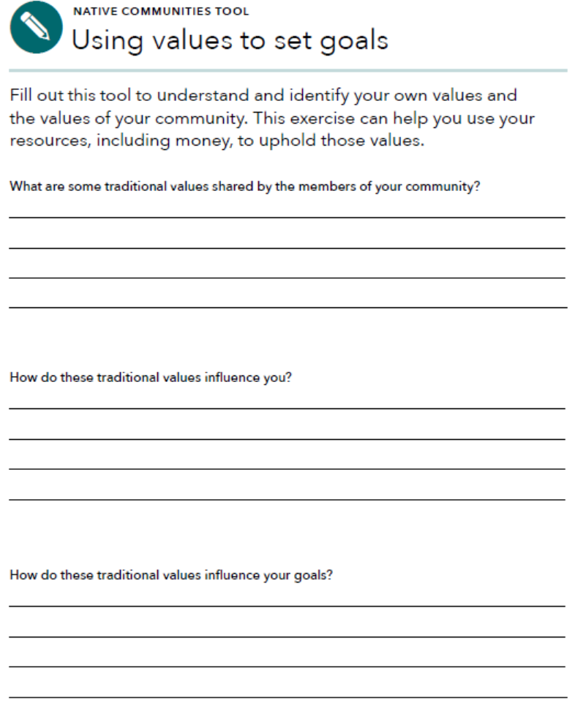
Using values to set goals
Values are the things that people consider most important in their lives.
A reflection on traditional values may make the information and tools on goal-setting and related topics in module 1 feel more relevant.
Notes:
Activity #3: Implementing Your Money, Your Goals and Focus on Native Communities CONTINUED
Presentation
Share excerpt from the Focus on Guide and review how to use Using values to set goals.

Slide 30
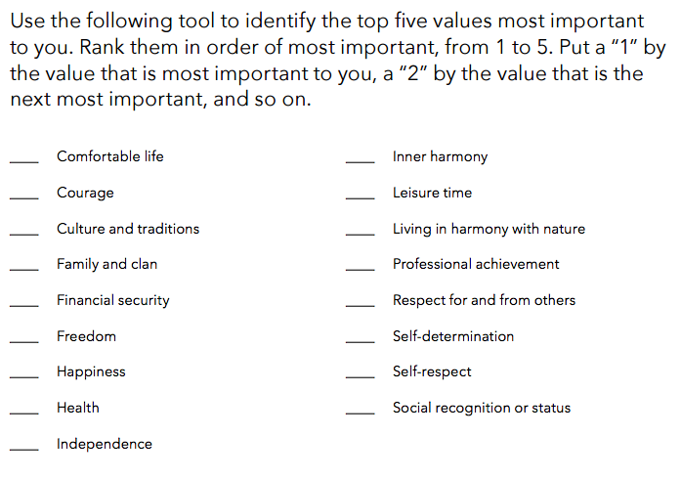
Native Communities Tool: Using values to set goals
Notes:
Activity #3: Implementing Your Money, Your Goals and Focus on Native Communities CONTINUED
Individual Activity, Vote with Your Body, and Facilitated Discussion
Prior to this activity, hang up signs with numbers 1 to 17 around the room. This is for a “vote with your body” exercise.
Explain the following:
Looking at community values can provide insight into those forces that most affect decision-making. Looking at your personal values can provide insight into how you use your personal resources and money.
Instruct participants to rank order the values listed on in Focus on Native Communities, page 34.
Instruct participants to put a “1” by the value that is most important to you, a “2” by the value that is the next most important, and so on through “17.”
Provide participants with 5 – 7 minutes to complete.
Once everyone is finished, explain that together you will explore values.
Explain that you will read off a value and that each person should stand under the number that represents.
Select any of the values that you think would be most interesting for the participants from the list:
Comfortable life
Courage
Culture and traditions
Family and clan
Financial security
Freedom
Happiness
Health
Independence
Inner harmony
Leisure time
Living in harmony with nature
Professional achievement
Respect for and from others
Self-determination
Self-respect
Social recognition
Status
After participants move to “vote” for the first value, facilitate a discussion among the participants regarding the reasons they ranked the value where they ranked it. If someone ranks a value #1 or #17, it can be interesting to start with them.
Generally, getting thoughts from 4 – 6 people after each value is the right amount.
After ranking 4 – 6 values, have people sit down.

Slide 31
Native Communities Tool: Using values to set goals
What were your top five values? Did these surprise you? What do these values say about you?
Do your goals reflect these values?
How do you think these values affect the way you manage your financial resources?
What is the value of an activity like this?
How can we use these insights in providing financial empowerment services to clients?
Notes:
Activity #3: Implementing Your Money, Your Goals and Focus on Native Communities CONTINUED
Individual Activity, Vote with Your Body, and Facilitated Discussion
Process the activity using the following questions:
What were your top five values? Did these surprise you? What do these values say about you?
Do your goals reflect these values?
How do you think these values affect the way you manage your financial resources?
What is the value of an activity like this?
How can we use these insights in providing financial empowerment services to clients?

Slide 32
Module 2: Saving for emergencies, bills, and goals
What is savings?
Savings is money you set aside today for use in the future
What are examples of unexpected expenses or emergencies?
Saving is about setting aside resources today so they can be used in the future. It’s about balancing your resources to take care of your family and community.
Notes:
Activity #3: Implementing Your Money, Your Goals and Focus on Native Communities CONTINUED
Presentation or Facilitated Discussion and Small Group Activity
Introduce this topic using the following key points from Focus on Native Communities, Page 37:
Traditionally, Native Communities lived in sustainable balance with their environment.
They only hunted or harvested what was needed to live for today so that resources would continue to be available in the future.
Saving money is based on the same principle: using the amount you need to live for today, but setting aside some money so it is available in the future. living for today and saving for the future are compatible values – it’s about balancing your resources.
For example, for community members whose work is seasonal, setting aside income today to cover the months when there is little or no work ensures sustainability within their household.
People in your community may avoid saving for fear of losing benefits – tribal, state, or federal benefits. Because savings are an asset, the relationship between asset limits and benefits is addressed in this module.
OR
ASK: What traditional or community values are related to savings?
Facilitate a discussion using the key points from Focus on Native Communities, Page 37 to add to the discussion.
Facilitated Discussion and Small Group Brainstorm (Module 2)
Ask participants to share their definition of savings.
Share definition of savings using slide.
Have participants list examples of unexpected expenses or emergencies in small groups on flip chart paper using marker.
After 3 minutes, ask participants to circle those they think could be handled with $1,000 or less.
Instruct groups to post their flip charts and share cumulatively.
Make summary comments about the number of unexpected expenses that can be managed with $1,000. Contrast to the “conventional wisdom” advocating 3 - 6 months’ worth of living expenses.
Explain that $500 to $1,000 is a possible goal for most—they can imagine it and it can make a very, very big difference.
Explain that having $500 to $1,000 to cover emergencies and unexpected expenses can help avoid debt.
Also explain the following: Once people see they can save this much, then they can work toward 1 month’s living expenses, 3 months’, etc. over the longer term.

Slide 33
Module 2: Saving for emergencies, bills, and goals
Use Tool 1: Savings plan to help you plan for and build your savings.
Use Tool 2: Savings and benefits to better understand how benefits may impact ability to save. Don’t forget to add benefits specific to your community.
Use Tool 3: Finding a safe place for savings to better understand the benefits and risks of different places to put your savings so you can make the best choice for you.
Use Tool 4: Increasing your income through tax credits to learn more about tax credits that may increase your income.
Native Communities Tool: Savings and asset limits in Native Communities includes information specific to tribal benefits.
Notes:
Activity #3: Implementing Your Money, Your Goals and Focus on Native Communities CONTINUED
Presentation
Review highlights of the four tools in referenced Module 2 and transition to the Native Communities tool.

Slide 34
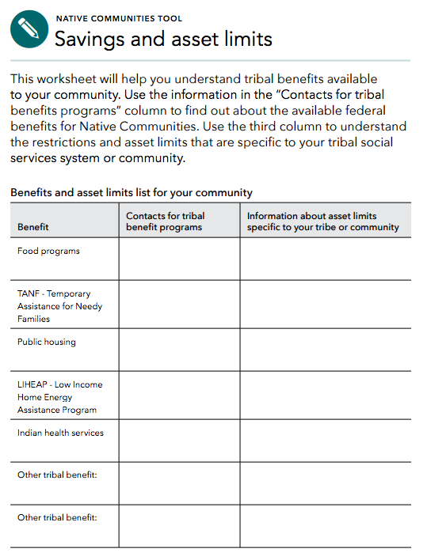
Native Communities Tool: Savings and asset limits in Native Communities
Notes:
Activity #3: Implementing Your Money, Your Goals and Focus on Native Communities CONTINUED
Presentation and Facilitated Discussion
Explain that this savings and asset limits too is an expansion of Tool 2: Savings and benefits from Module 2 in the Toolkit. It is designed to help understand tribal benefits and asset limits.
ASK: Why do you think this tool is a part of the module on savings.
Explain that asset limits set maximum amount of personal property and money someone can have and still receive benefits.
Explain that for people receiving benefits, a key is ensuring that savings is not encouraged at the expense of benefits.
Before introducing this tool to people in your community, you may want to consider adding the benefits that are specific to Native Communities generally and your community specifically.
Ask people to share about the community and tribal benefits that they know about as well as the asset limits associated with them.
Write them on a flip chart.

Slide 35
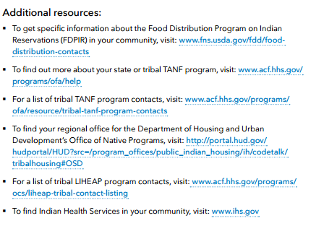
Native Communities Tool: Savings and asset limits in Native Communities
Notes:
Activity #3: Implementing Your Money, Your Goals and Focus on Native Communities CONTINUED
Presentation and Facilitated Discussion
Explain that the tool also includes links to more information about tribal benefits.

Slide 36
Module 3: Tracking and managing income and benefits
Income
Regular income
Irregular income
Seasonal
One-time occurrence
Benefits
Wage garnishments
Tracking and managing income and benefits empowers people to plan to take care of basic necessities, care for family members, and reach goals.
Notes:
Activity #3: Implementing Your Money, Your Goals and Focus on Native Communities CONTINUED
Facilitated Discussion
Define income.
Ask participants to differentiate regular, irregular, seasonal, and one-time income.
ASK: How do these different kinds of income impact budgeting and cash flow?
ASK: How are benefits (public) different from income?
Discuss the following key points with participants using information from Focus on Native Communities, Page 43:
While many of your community members may earn income from jobs, businesses they own and operate, or traditional livelihoods, they may also receive income from dividends distributed by the tribal government or money from trust accounts.
This money may come from tribal enterprises including gaming, the sale or lease of land and other natural resources owned by the tribe, or because of legal settlements to the tribe.
Called “per capita payments,” these may be distributed in several ways:
On a regular basis (once per month, two times a year, or annually)
Periodically All at one time (commonly called windfall payments)
As noted in information about savings, some kinds of per capita payments, but not all, can be excluded as income, a resource, or an asset when determining your eligibility for a federal assistance program. These programs include Temporary Assistance for Needy Families, Supplemental Nutrition Assistance Program, Supplemental Security Income, housing assistance programs administered by Housing and Urban Development, or the Low Income Home Energy Assistance Program.
Qualification for government benefits varies by program. Individuals seeking to receive benefits under them should review the qualifications carefully to determine their entitlement.
There are also special federal laws that specify how certain payments are treated for purposes of eligibility for federally-assisted programs. For example:
Payments from income of lands held in trust or from an eligible tribal trust account: The first $2,000 you receive from these types of payments in a given year cannot be counted as income.
Payments from legal settlements with the U.S. government, such as the Cobell v. Salazar settlement, cannot be counted. However, federal assistance programs administered by the Social Security Administration and Housing and Urban Development, limit how long these payments are excluded from being considered income or a resource for the purposes of eligibility to one year.
If you receive payments like these, it is important to make sure you keep good records of the payments, where they came from, and when you receive them.
It will be important for you to show where your income comes from if you are planning to claim that the income should not be counted as a resource or asset when applying for a federal assistance program.
Per capita payments may also be deposited into Individual Indian Money (IIM) accounts and held in trust. These accounts are managed by the Office of the Special Trustee within the U.S. Department of the Interior.
For minors, IIM accounts may continue to grow until the minor turns 18 years old or is legally emancipated.
In some communities, this is called “18-money.” Young people anticipate its arrival, but some do not plan for how they will use it when they receive it.
Planning with irregular or annual per capita payments may be harder.
But without a plan, individuals may miss the chance to build and grow family and community resources for the future
A plan can help someone use their irregular or annual per capita payments to pay down debt, save for emergencies, help family members, or save for the months when there is little or no income.
All of these activities build family and community wealth and security.
These funds can also be used to invest in assets that can help create financial security and wealth, such as reliable transportation, additional education or training, tools to engage in traditional livelihoods, or business enterprises.
Explain wage garnishment using the following from the materials in Module 3 (Page 115) not covered during Module 2:
Wage garnishments give the government or creditors the right to collect money directly out of someone’s paycheck. This can generally only happen with a court order. Common reasons for wage garnishment are:
Taxes owed to the IRS or the state
Money owed for child support
Money owed for delinquent student loans
Other unpaid or delinquent debts
With a wage garnishment order, only a certain percentage of the employee’s disposable earning can be withheld.
Federal law limits the amount that may be garnished.
Generally the amount must be the lesser of two figures: 25% of disposable income or the amount that the person earns each week over the federal minimum wage multiplied by 30. You may wish to direct participants to the example in the toolkit.
Some states provide additional protections that allow consumers to take home more pay than would be allowed using only the federal limits.
All mandatory deductions are protected outright from garnishment:
Federal, state and local taxes, and
FICA contributions.
Voluntary deductions are not protected.
Generally, Social Security, disability, retirement, child support, and alimony are protected from garnishment from regular creditors.
If you owe the federal government for student loans or back taxes, however, these sources may not be protected.
Finally, some states have additional protections. Find a legal aid organization in your community to learn more about protections from wage garnishment.

Slide 37
Module 3: Tracking and managing income and benefits
Use Tool 1: Income and resource tracker to help you understand when and how much income and benefits you receive.
Use Tool 2: Ways receive income and benefits to better understand the benefits and risks of different ways of receiving income and benefits.
Use Tool 3: Ways to increase cash and financial resources to identify ways to possibly increase your income or financial resources.
Native Communities Tool: Making the most of the IIM can help young adults and others who are receiving IIM or other large payments.
Notes:
Activity #3: Implementing Your Money, Your Goals and Focus on Native Communities CONTINUED
Presentation
Review highlights of the 3 tools referenced in Module 3 and transition to the Native Communities tool.

Slide 38
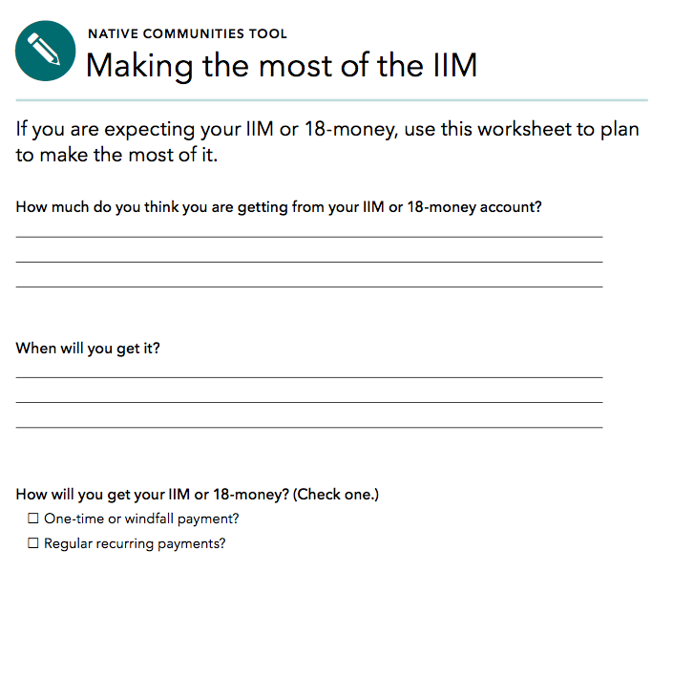
Native Communities Tool: Making the most of the IIM
Notes:
Activity #3: Implementing Your Money, Your Goals and Focus on Native Communities CONTINUED
Individual Activity and Large Group Discussion
Explain that Native Communities Tool: Making the most of the IIM on pages 46 – 47 in the Guide for Native Communities can help young adults and others who are receiving IIM or other large payments consider how they can build a plan to spend or save that reflects their values and helps achieve their goals.
Show excerpt from the tool on this slide and the next.
Ask participants to individually review the tool.
After 5 minutes, ask participants about their reactions to this tool using the following questions:
What about this tool do you think would be useful if working with someone getting their IIM?
What questions would you ask that are not included on the tool?
Write these on a flip chart or white board.
When could you see using this tool?
Write these on a flip chart or white board.

Slide 39
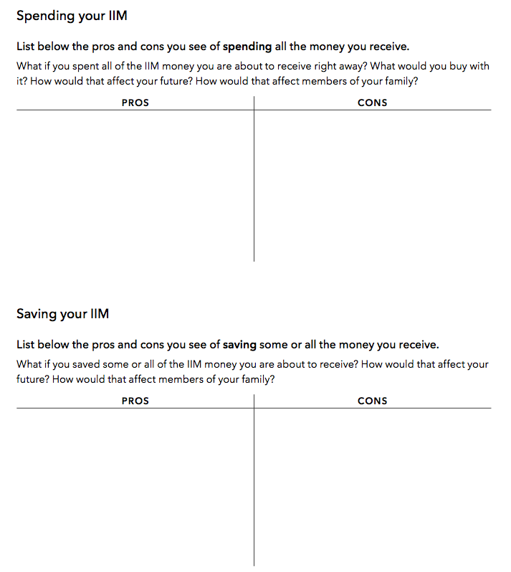
Native Communities Tool: Making the most of the IIM
Notes:
Activity #3: Implementing Your Money, Your Goals and Focus on Native Communities CONTINUED
Individual Activity and Large Group Discussion
Explain the following points in summary:
Managing income and benefits is essential to financial empowerment. Many people do not think about their income beyond the amount they receive.
Understanding issues of timing and predictability can help you take control of your finances. And if you find you don’t have enough money, it’s important to identify strategies that can help you bring in more income or resources.
Some ways of receiving income may be more beneficial to you than others. Understanding the benefits and risks of a paper paycheck versus direct deposit versus a payroll card can empower you to make a different choice that may benefit you and your family.
Finally, people receiving their IIM or 18-money may not consider ways to maximize the value of this money through planning. Use tool Making the Most of the IIM to provide them the opportunity to think through the pros and cons of spending and saving this money and how their use of this lump sum relates to their values and goals.

Slide 40
Paying bills and other expenses
Spending
Money you use to pay for a wide range of basic needs, your financial obligations, and other things you may want.
How you use your money is often a reflection of values. But, there are individual consequences for not paying your bills on time or repaying debts. This happens regardless of the contributions you have made to your family or community.
Notes:
Activity #3: Implementing Your Money, Your Goals and Focus on Native Communities CONTINUED
Presentation and Facilitated Discussion
Define spending.
Further connect the content by sharing the following key points from Focus on Native Communities, Page 51:
How people use their money is often a reflection of their individual, family, and cultural values. For example, you may prioritize using some of your resources to provide family members with assistance or invest in helping your community.
When it comes to your personal financial resources, the U.S. financial system will reward or penalize you based on whether you pay your bills on time and repay debt according to the agreement, regardless of the contributions you have made to your family or community. For example, your history of using credit is captured and reflected in your credit reports and credit scores. And having a poor credit history and scores could result in your paying more for loans and credit cards and, for example, paying higher utility and cell phone plan deposits. This could leave you with less money to spend on things you value more highly.
Making decisions about how to use your financial resources is ultimately about balance – balancing your individual and family needs for shelter, food, and clothing with your personal or cultural values that may emphasize sharing with others.
Share the quote.

Slide 41
Module 4: Paying bills and other expenses
Use Tool 1: Spending tracker to understand how you use your money now.
Use Tool 2: Bill calendar to create a visual reminder of when your bills are due and how much is due.
Use Tool 3: Ways to pay bills: Know your options to better understand the advantages and disadvantages of different methods for paying bills.
Use Tool 4: Strategies for cutting expenses to identify ways to cut spending.
Use Tool 5: When cash is short—prioritizing bills and planning spending to help you develop a short-term plan to get through times when you do not have enough income to cover your needs, wants, and obligations.
Notes:
Activity #3: Implementing Your Money, Your Goals and Focus on Native Communities CONTINUED
Presentation and Facilitated Discussion
Review highlights of the 5 tools in referenced Module 4.
ASK: Which of these tools could you see using with the people you serve? Why?
ASK: How could you envision using the tool(s)?

Slide 42
Module 5: Getting through the month
What is a cash flow budget?
How is it different from a regular budget?
What do you think may be the benefit of this approach for your clients?
Native Communities have planned for the use and conservation of natural resources for thousands of years. Cash flow budgeting applies those principles to financial resources and income.
Notes:
Activity #3: Implementing Your Money, Your Goals and Focus on Native Communities CONTINUED
Facilitated Discussion
Explore what participants know about cash flow by asking: “What is a cash flow budget?”
After participants offer some ideas, share definition: A projection of how you will get and use your cash and other financial resources.
Contrast cash flow to regular budget by asking: “How is a cash flow budget different from a regular budget?”
After participants offer some ideas, share definition: A cash flow budget tracks the timing of income and spending. This is key.
ASK: What do you think may be the benefit of this approach for your clients?
Further connect this concept using the following key points from Focus on Native Communities, Page 53:
Planning the use and conservation of resources is something Native Communities have practiced for thousands of years.
For example, some communities may have hunted in the late winter and early spring. They stopped hunting during the spring birthing season and switched to preparations for planting crops. Such careful planning and follow through enabled herds to repopulate, so that they would be a sustainable resource in the future. It also ensured there were crops to harvest in the late summer and early fall.
Cash flow budgeting is an extension of this concept of planning. Instead of natural resources, however, it is planning with financial resources and income.
Module 5 provides information and tools to help people make plans to get through the month – pay for all of their living expenses, bills, financial obligations, and other uses of income or financial resources, including saving and sharing with family and the community.
The toolkit uses a cash flow budget approach that looks at the timing of income and expenses from week to week. People sometimes experience shortfalls because of when income or financial resources are received and when their bills are due. These week-by-week shortfalls can be missed in a monthly static budget.

Slide 43
Module 5: Getting through the month
Use Tool 1: Cash flow budget to help people create their own cash flow.
Use Tool 2: Cash flow calendar as an alternative format for creating a cash flow.
Use Tool 3: Improving cash flow checklist to identify specific strategies for improving cash flow.
Native Communities Tool: Annual planning tool is provided as a supplement to these tools.
Notes:
Activity #3: Implementing Your Money, Your Goals and Focus on Native Communities CONTINUED
Presentation
Review highlights of the three tools in referenced Module 5 and transition to the Native Communities tool.

Slide 44
Cash flow budget
 | Week 1 | Week 2
Beginning balance for the week | $37.00 | $122.37
Sources of cash and other financial resources
Income from job | $305.34 | $290.80
SNAP | $280.00
Public housing voucher | $650.00
Total sources of cash and other financial resources | $1,272.34 | $413.17
Uses of cash and other financial resources
Savings | $20.00 | $20.00
Housing | $650.00
Utilities | $59.97 | $95.50
Groceries | $180.00 | $80.00
Eating out (meals and beverages)
Transportation | $240.00 | $60.00
Total uses of cash and other financial resources | $1,149.97 | $255.50
Ending balance for the week | $122.37 | $157.67
Ending balance from previous week
To get a starting balance, total your cash, debit card , and account balances.
Notes:
Activity #3: Implementing Your Money, Your Goals and Focus on Native Communities CONTINUED
Presentation
Review the components of a cash flow.

Slide 45
Cash flow budget
 | Week 1 | Week 2
Beginning balance for the week | $37.00 | $122.37
Sources of cash and other financial resources
Income from job | $305.34 | $290.80
SNAP | $280.00
Public housing voucher | $650.00
Total sources of cash and other financial resources | $1,272.34 | $413.17
Uses of cash and other financial resources
Savings | $20.00 | $20.00
Housing | $650.00
Utilities | $59.97 | $95.50
Groceries | $180.00 | $80.00
Eating out (meals and beverages)
Transportation | $240.00 | $60.00
Total uses of cash and other financial resources | $1,149.97 | $255.50
Ending balance for the week | $122.37 | $157.67
Total sources minus total uses
This becomes your beginning balance for next week.
Notes:
Activity #3: Implementing Your Money, Your Goals and Focus on Native Communities CONTINUED
Presentation
Review the components of a cash flow.

Slide 46
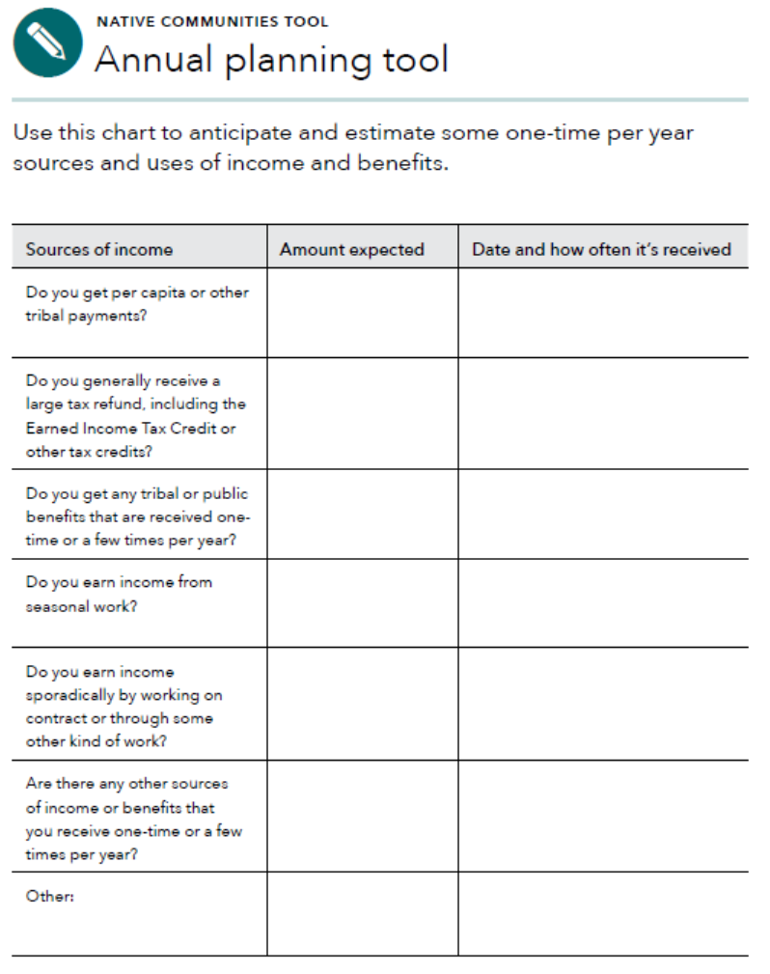
Annual planning tool
Using the cash flow budget can be difficult for people who have sporadic or seasonal income and periodic expenses.
The annual planning tool can be used to help someone think through when their income may come in—irregular, seasonal, or even one-time income.
Notes:
Activity #3: Implementing Your Money, Your Goals and Focus on Native Communities CONTINUED
Presentation
Explain that using the cash flow budget can be difficult for people who have sporadic or seasonal income and periodic expenses.
Explain that this annual planning tool (Guide for Native Communities, pages 56 – 59) can be used to help someone think through when their income may come in and when they may have irregular expenses.
Explain that they should start by asking individuals the questions about income and uses of income listed in the first part of the tool.

Slide 47
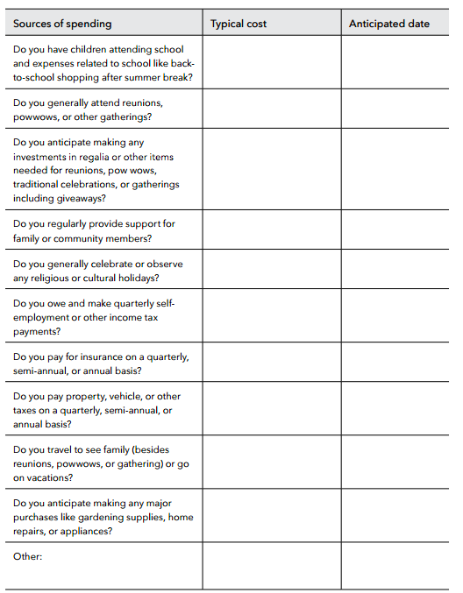
Annual planning tool
The annual planning tool can also help someone identify when they may have irregular expenses.
Identifying the timing and the approximate amount of these expenses can help someone plan to have the money on hand or save for the expense.
Notes:
Activity #3: Implementing Your Money, Your Goals and Focus on Native Communities CONTINUED
Presentation
Explain that using the cash flow budget can be difficult for people who have sporadic or seasonal income and periodic expenses.
Explain that this annual planning tool (Guide for Native Communities, pages 56 – 59) can be used to help someone think through when their income may come in and when they may have irregular expenses.
Explain that they should start by asking individuals the questions about income and uses of income listed in the first part of the tool.

Slide 48
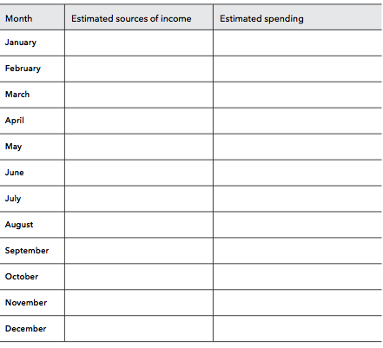
Annual planning tool
Notes:
ACTIVITY #12: Getting through the Month CONTINUED
Presentation and Reflection Question
Explain that once these questions are answered, the information can be used to complete the annual planning calendar (Guide for Native Communities, pages 56 – 59).
Encourage individuals to put this calendar in a place they can see it. This visual reminder may help them remember when sporadic expenses are coming due and when they can anticipate additional income.
Optional—Individual Activity
Have participants complete this tool for themselves—nearly everyone has irregular expenses and many people have irregular, seasonal, or even one-time (annual) income.
Have people share their experiences completing the tool.
Explain the following in summary:
A cash flow budget is a projection of how you will get and use your cash and other financial resources.
A cash flow budget is different from a regular budget, because it includes not only the amount for each budget item, but also the timing of your income and expenses.
This is important because people often find themselves flush with cash one week—and splurge on something fun—but come up short the next week for a necessity.
Timing matters. A cash flow budget will help an individual identify where she is falling short within the month. It can help her ensure she has the financial resources on hand to cover the most important expenses—so she doesn’t fall short covering the rent, for example. A cash flow budget can better help an individual target areas where they could consider cutting back.
For people that have periodic or irregular income or spending, the annual planning tool may help them get the most out of a cash flow budget.
Remember, sometimes there is not enough money to cover the month. In this case it is important to develop a short-term plan to prioritize bills and pay those that protect income, shelter, assets, and continue obligations. This can help responding in the moment to a high pressure debt collector collecting on a lower priority debt. But when making these decisions, people should be fully aware of the consequences and know money not paid today will become a debt in the future.
ASK: How could you see using these tools?

Slide 49
Module 6: Dealing with debt?
What is debt?
Money you owe.
Debt is a liability.
Debt may obligate future income.
How is debt different from credit? For our purposes…
Credit is the ability to borrow money.
Debt is the result of using credit.
Notes:
Activity #3: Implementing Your Money, Your Goals and Focus on Native Communities CONTINUED
Facilitated Discussion
ASK: What is a debt?
After participants offer some ideas, share definition: Money you owe to another person or business. Debt is a liability. Debt may obligate future income.
ASK: How is debt different from credit?
After participants offer some ideas, share definition: Credit means you can borrow money. Debt is the result of using credit. Credit is not a liability. When you use it, though, you create a liability.
ASK: How is secured debt different from unsecured debt?
After participants offer some ideas, share definitions: Secured debt is debt that has an asset attached to it. The difference involves the inclusion of collateral. When debt is secured, a lender can collect that asset/collateral if you do not pay.
Ask participants for examples of secured debt.
After participants offer some ideas, share examples:
A home loan—the debt is secured with the home you are buying. If you do not pay your loan, the lender will foreclose on your home, sell it, and use the money from the sale to cover your loan.
An auto loan—the debt is secured with your car. If you do not pay your loan, the lender will repossess (repo) your car and sell it to cover the loan.
A payday loan—the debt is secured with your post-dated check. If you do not renew the loan, the check will be cashed.
A pawn loan—the debt is secured with the item you have pawned. If you do not make payment when it is due, the pawned item is sold to the general public.
A rent-to-own loan—the debt is secured with the items (furniture, fixtures, electronics, appliances) you are making payments on. If you do not make your payments, the item is repossessed and made available to someone else to rent. You do not get back any rental payments you have made.
Unsecured debt does not have an asset attached to it.
Ask participants for examples of unsecured debt.
After participants offer some ideas, share examples:
Credit card debt
Department store charge card debt
Signature loans
Medical debt
Student loan debt
Explain the purpose of this module:
Debt obligates future resources to cover decisions made today. Understanding debt, how to manage it, and how to reduce and get rid of it are important components of financial empowerment.

Slide 50
What is debt?
Debt obligates future resources to cover decisions made today. Understanding debt, how to manage it, and how to reduce and get rid of it, are important components of financial empowerment.
Notes:
Activity #3: Implementing Your Money, Your Goals and Focus on Native Communities CONTINUED
Presentation
Explain the purpose of this module:
Debt obligates future resources to cover decisions made today. Understanding debt, how to manage it, and how to reduce and get rid of it, are important components of financial empowerment.
Make the following points to further connect this material to the participants using the information from the Guide for Native Communities, page 61:
For Native Communities that embrace a perspective based on living in harmony with the world and people around you having or even discussing debt may create a conflict.
This is because debt is about borrowing from the future and may upset that harmony.
Debt obligates future resources to cover decisions made today.
Debt, however, is a current reality in many communities – communities may have debt due to money raised for improvements that benefit everyone, businesses may have debt to enable them to expand.
Families and individuals may have debt related to buying or repairing a home, buying a car or truck, starting a business, getting their children education and training after high school, or emergency expenses.
Understanding debt, how to manage it, and how to reduce and get rid of it, are important components of financial empowerment.

Slide 51
Module 6: Dealing with debt
Use Tool 1: Debt worksheet to make a list of your debts and the details associated with each debt—this is the foundation of a debt reduction plan.
Use Tool 2: Debt-to-income worksheet to figure out how much of your income is going to cover your debts on a monthly basis.
Use Tool 3: Reducing debt worksheet to identify a strategy for reducing or eliminating your debts.
Use Tool 4: Repaying student loans to understand some of the key terms related to student loans as well as repayment options.
Use Tool 5: When debt collectors call: Steps you can take to help you understand your rights in debt collection.
Notes:
Activity #3: Implementing Your Money, Your Goals and Focus on Native Communities CONTINUED
Sharing experiences and Presentation
ASK: What are some experiences you have had with debt that you are willing to share?
Review highlights of the five tools in referenced in Module 6.

Slide 52
Module 7: Understanding credit reports and scores
Your Money, Your Goals toolkit includes information to help you understand what credit reports and scores are, what goes into them and why they’re important.
Notes:
Activity #3: Implementing Your Money, Your Goals and Focus on Native Communities CONTINUED
Facilitated Discussion
Introduce this topic using the following key points from the Guide for Native Communities, page 63:
Financial issues can be tough to talk about in Native Communities because so many concepts that relate to them may, on their surface, seem individualistic.
This can conflict with values of sharing resources with family, clan, and community.
In no situation is this clearer than when discussing credit reports and scores.
in cultures that strongly value sharing and family and community needs, a key to understanding credit reports and scores is that a person’s financial actions ultimately have individual consequences.
For example, not paying an auto loan so you can help a family member with a financial need may result in having your car repossessed. And this could have other consequences including not being able to get to your job, which lessens your ability to help family members in the future.
Finally, not paying your auto loan payment could mean a negative entry on your credit report and a significant drop in your credit scores. This may create other challenges like not being able to secure a better paying job or buy a home or other asset.
This module provides information and tools to help people get, review, and improve their credit report and scores.
ASK: What is a credit report?
After people share their ideas, explain that it is a consumer report that is a written history of some of your bill paying history, including loans, credit cards, and other credit accounts you have or have had in the past.
A credit report also includes accounts that have gone to collection, public record information, and a record of how much credit has been applied for.

Slide 53
Module 7: Understanding credit reports and scores
Header/identifying information
Public record information
Collection agency account information
Credit account information
Inquiries made to your account
Notes:
Activity #3: Implementing Your Money, Your Goals and Focus on Native Communities CONTINUED
Facilitated Discussion
NOTE—If training participants have received the full Your Money, Your Goals training, you can skip this slide through slide 56. It contains basic information about getting credit reports.
ASK: What is in the header Identifying information?
After they share some thoughts, add to it using the following information.
Header/identifying information—This includes your name and current address, as well as other information that can be used to distinguish or trace your identity, either by itself, like your Social Security number, or when combined with other personal information, including date and place of birth.
This information may not be complete—all of the jobs you have held, for example, may not be listed. But what is listed should be accurate. A credit report does not include some personal information such as race or ethnicity.
ASK: What is in the public record information?
After they share some thoughts, add to it using the following information
Public record information—This section includes public record data of a financial nature, including consumer bankruptcies, judgments, and state and federal tax liens.
Records of arrests and convictions generally do not appear on your credit file, but other types of consumer reporting agencies, such as employment background screening agencies, often include them.
Other public records that usually do not appear in credit reports are marriage records, adoptions, and records of civil suits that have not resulted in judgments.
ASK: What is in the collection agency account information?
After they share some thoughts, add to it using the following information
Collection agency account information—This section will show if you have any accounts with a collection agency and the status of those accounts.
ASK: What is in the credit account information?
After they share some thoughts, add to it using the following information
Credit account information—This section may include accounts you have now or that you had before with creditors.
This includes:
The company name
Account number
Date opened
Last activity
Type of account and status
Date closed if the account is no longer open
Credit limit
Items as of date (any amount currently owed and whether you are current or late with payments)
The balance
Whether you have a past due amount
The date information was reported to the credit bureau.
Some accounts may not be listed, especially older accounts or those you have closed. So there may be inconsistencies across credit files and credit reporting agencies in the contents of this section. It is important to make sure what is listed, however, does or did belong to you.
ASK: What are inquiries?
After they share some thoughts, add to it using the following information
Inquiries made to your account—Companies look at your credit report when you apply for credit, when they review your account, or when they offer you a special promotional rate.
When you apply for credit and a lender reviews your credit report, it is listed as an “inquiry” on your report.
Promotional inquiries, periodic reviews of your credit history by one of your creditors, and your requests for a copy of your report aren’t listed as an “inquiry.”

Slide 54
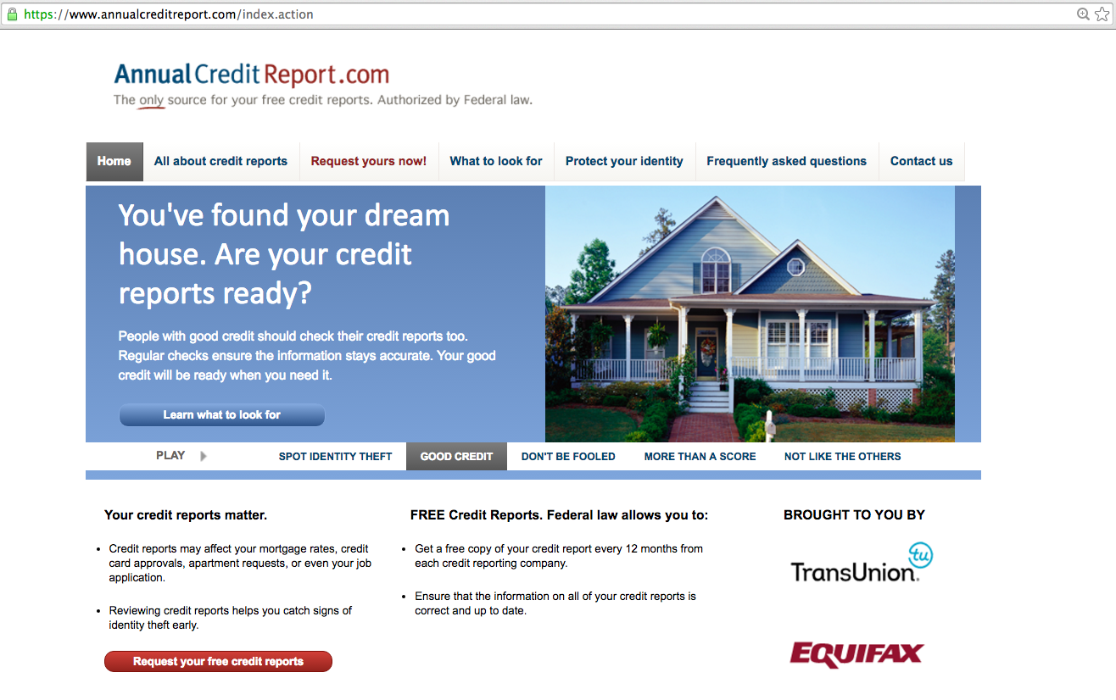
Getting free, annual credit reports
Notes:
Activity #3: Implementing Your Money, Your Goals and Focus on Native Communities CONTINUED
Presentation and Facilitated Discussion
Review how to get free, annual credit reports from Equifax, Experian, and TransUnion using Annualcreditreport.com.
Ask participants to share their experiences getting their free, annual credit reports.

Slide 55
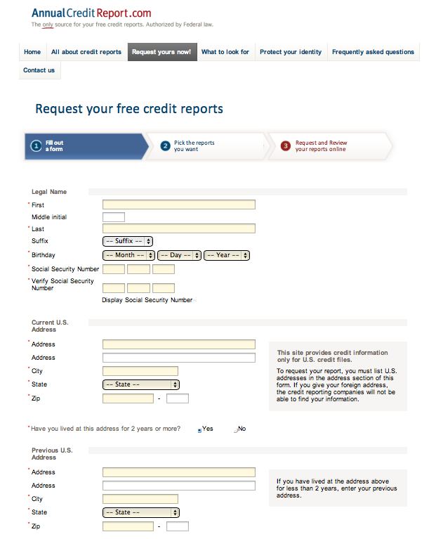
Getting your report online
Notes:
Activity #3: Implementing Your Money, Your Goals and Focus on Native Communities CONTINUED
Presentation
To order through the website, visit: https://www.annualcreditreport.com
Complete a form with basic information (name, Social Security number, address, etc.).
Select the report(s) you want—Equifax, Experian, and/or TransUnion.
Answer security questions: former addresses, amount of a loan you have, phone numbers that have belonged to you, counties you may have lived in, etc.
If you are unable to answer these questions, you will have to use another method.
You will save a PDF version of your report, print the report, or both.
Be sure you do this in a safe and secure location. Avoid doing this on public computers (library).
There are other types of “specialty” reports and scores, e.g., for checking accounts. Visit consumerfinance.gov for a list

Slide 56
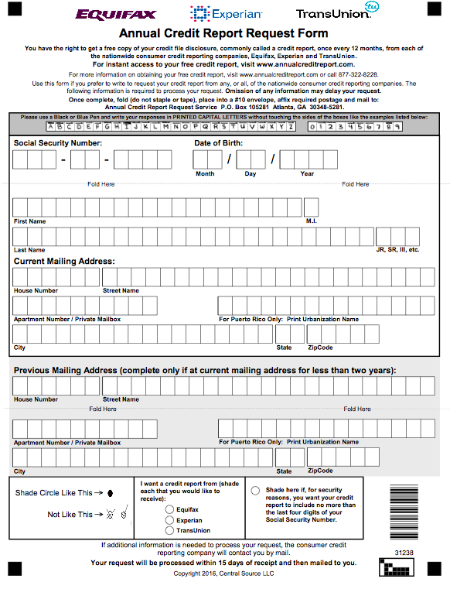
Getting your report by mail Download and complete the Annual Credit Report Form and mail it to: Annual Credit Report Request Service P.O. Box 105281 Atlanta, GA 30348-5281 https://www.annualcreditreport.com/manualRequestForm.action
Notes:
Activity #3: Implementing Your Money, Your Goals and Focus on Native Communities CONTINUED
Presentation
Review getting your report by mail.

Slide 57
Module 7: Understanding credit reports and scores
Use Tool 1: Getting your credit reports and scores to help people get their credit reports and scores.
Use Tool 2: Credit report review checklist to help people read and review their credit reports and file disputes for inaccurate or incomplete information identified on reports.
Use Tool 3: Improving your credit reports and scores to provide people with steps to improve both credit reports and scores.
Use Tool 4: Keeping records to show you’ve paid your bills to provide people with a simple system to keep records so they have evidence for disputes on credit reports.
Notes:
Activity #3: Implementing Your Money, Your Goals and Focus on Native Communities CONTINUED
Presentation
Review highlights of the four tools in referenced in Module 6.

Slide 58
Module 8: Money services, cards, accounts, and loans: Finding what works for you
Financial products and services can help people
Protect their money and financial resources
Better manage their money
More efficiently pay for their current living expenses
Set aside money for their goals or for future generations
Choosing the right financial products and services for you can help you protect and better manage your money and financial resources to achieve your goals.
Notes:
Activity #3: Implementing Your Money, Your Goals and Focus on Native Communities CONTINUED
Presentation
Use the following key points from Focus on Native Communities, Page 65 to connect the materials to the participants in ways that may be more culturally relevant:
Historically, many Native Communities lacked access to financial products, services, and providers.
While access is not yet universal, access to appropriate and safe financial products and services has improved because of:
Native Community Development Financial Institutions (Native CDFIs) including credit unions and community banks.
Increased awareness among banks and credit unions to better serve Native Communities.
The emergence of online bank and credit union products and services.
Many types of financial products and services can help people protect their money and financial resources, better manage their money, more efficiently pay for their current living expenses, and set aside money for their goals or for future generations.
Protecting what you have as a community ensures it will be there not only today, but also tomorrow and in future generations.
Your Money, Your Goals takes a financial empowerment approach to financial products and services; rather than directing people to a particular type of provider or service, this module starts with an assessment of your needs or priorities and – based on those needs – helps you choose from among your options.
With this information, you can make the choices that are best for you and your family.

Slide 59
Module 8: Money services, cards, accounts, and loans: Finding what works for you
Use Tool 1: Know your options: Money services, cards, accounts, and loans (Which financial product or services do you need?) to help you figure out which financial products or services will meet your needs
Use Tool 2: Ask questions: Choosing where to get what you need (Comparing financial service providers) to help you compare financial service providers based on their characteristics as well as the features and benefits of the products and service they offer.
Use Tool 3: Money services and banking basics (The basics of financial products and service) to help you learn about the different financial products and services offered at banks, credit unions, and other financial service providers.
Notes:
Activity #3: Implementing Your Money, Your Goals and Focus on Native Communities CONTINUED
Presentation
Review highlights of the five tools in referenced in Module 6.

Slide 60
Module 8: Money services, cards, accounts, and loans: Finding what works for you
Use Tool 4: Opening an account checklist to understand the specific steps for opening an account including information you may want to have before opening an account.
Use Tool 5: Money transfers and remittances: What you need to know to learn more about using these products and services.
Notes:
Activity #3: Implementing Your Money, Your Goals and Focus on Native Communities CONTINUED
Presentation
Review highlights of the five tools in referenced in Module 8
ASK: When could you see using these tools in your community?

Slide 61
Module 9: Protecting your money
Protecting what you have as a community ensures it will be there today and for future generations. When it comes to protecting your money, there are laws that give you rights.
Notes:
Activity #3: Implementing Your Money, Your Goals and Focus on Native Communities CONTINUED
Presentation
Provide the following introduction to this topic:
One important job of tribal leaders is to protect the assets that belong to the tribe.
These assets could be land or the natural resources that come from the land. These assets could be tribal enterprises built by community members, from banks to grocery stores to consulting firms to casinos. They could be money that comes from settlements with the U.S. government or corporations. They could also be community traditions including ceremonies, traditional ways of life, and language.
Protecting what you have as a community ensures it will be there not only for today, but also for tomorrow and future generations.
When it comes to protecting your money and financial resources, there are laws that give you rights. Module 9: Protecting your money provides an introduction to some of these laws as well as an overview of how to protect your identity and how to determine that a financial product or service may not be a good deal for you.

Slide 62
Module 9: Protecting your money
If you do feel like you have a complaint with a financial product, service or provider submit a complaint with the CFPB using Tool 1. Submitting a complaint to the CFPB and visit: http://www.consumerfinance.gov/complaint/
Your identity is one of the most important assets you must protect. Use Tool 2: Protecting your identity to ensure you are taking all steps possible to keep your identity safe.
When applying for financial products or services, be aware of red flags. Use Tool 3: Red flags to become familiar with common red flags.
If you are interested in learning more about consumer protection laws, use Tool 4: Learning more about consumer protection.
Notes:
Activity #3: Implementing Your Money, Your Goals and Focus on Native Communities CONTINUED
Presentation
Review highlights of the four tools in referenced in Module 9.

Slide 63
Your Money, Your Goals
Financial Empowerment and Elders

Slide 64
What is elder financial exploitation?
Elder financial exploitation is the illegal or improper use of an older person’s:
funds,
property, or
assets.
This can occur through fraud or scams, or when caregivers, family members, or others improperly use an elder’s financial resources.
Notes:
Activity #4: Financial Empowerment and Elders
Estimated Time: 30 Minutes
Methodology: Various methodology
Corresponding Sections: Content Module of Focus on Native Communities starting on page 71
Facilitated Discussion and Sharing Experiences
Before showing the above slide, ask:
What is elder financial exploitation?
Ask people if they are willing to share their story about someone they know that has been the victim of elder financial exploitation.
Thank participants for their contributions.

Slide 65
Financial empowerment and elders
The traditional value of respect for elders is not a guarantee against elder financial exploitation. But that value can be used to encourage community members to learn about all types of elder abuse and empower everyone to take action to prevent and report these crimes.
Notes:
Activity #4: Financial Empowerment and Elders CONTINUED
Presentation
Explain the following points in summary:
Elders are one of the most important resources in the community.
They are often in the uncomfortable position of having to rely on others from big tasks like home repairs, to daily chores like cooking and cleaning, to financial management and so on.
This can put them in a position where people have opportunities to abuse and exploit them.

Slide 66
Financial empowerment and elders
Three tools in Focus on Native Communities:
Identifying elder financial exploitation.
Getting help for elder financial exploitation.
Preventing elder financial exploitation.
Notes:
Activity #4: Financial Empowerment and Elders CONTINUED
Small Group Exercise
Put participants into small groups.
Assign each group the task of generating a list based on one of the three categories above.
Have them write their ideas on flip chart paper so the groups’ work can be posted.
If you have more than three groups, more than one group will be working on item number one and so forth.
Give groups 5 – 7 minutes to complete their lists.
Have groups report out cumulatively—have all of the groups working on #1 report out with each subsequent group only sharing what adds to the contributed share by groups that presented before them.
Transition by stating the tools in this section cover those same topics.
Have them compare their lists with those in the guide.
Have them add any ideas generated by the groups to their tool in the book if not already listed.

Slide 67
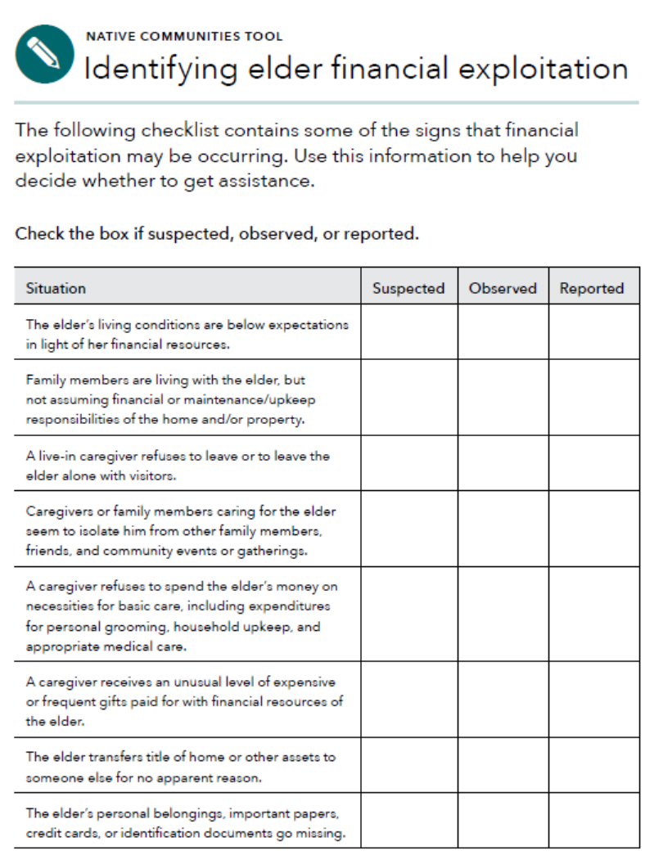
Identifying elder financial exploitation
Use this checklist to educate community members about elder financial exploitation.
It can be used one-on-one if someone expresses concern about an elder and his or her living conditions, care, or financial situation.
Responses to the questions included in the checklist can help you or the individual you are working with get assistance.
Notes:
Activity #4: Financial Empowerment and Elders CONTINUED
Presentation
Explain that the first tool, “Identifying elder financial exploitation,” is designed to help individuals spot a potential instance of financial abuse or exploitation. In may ways, these are the red flags.

Slide 68
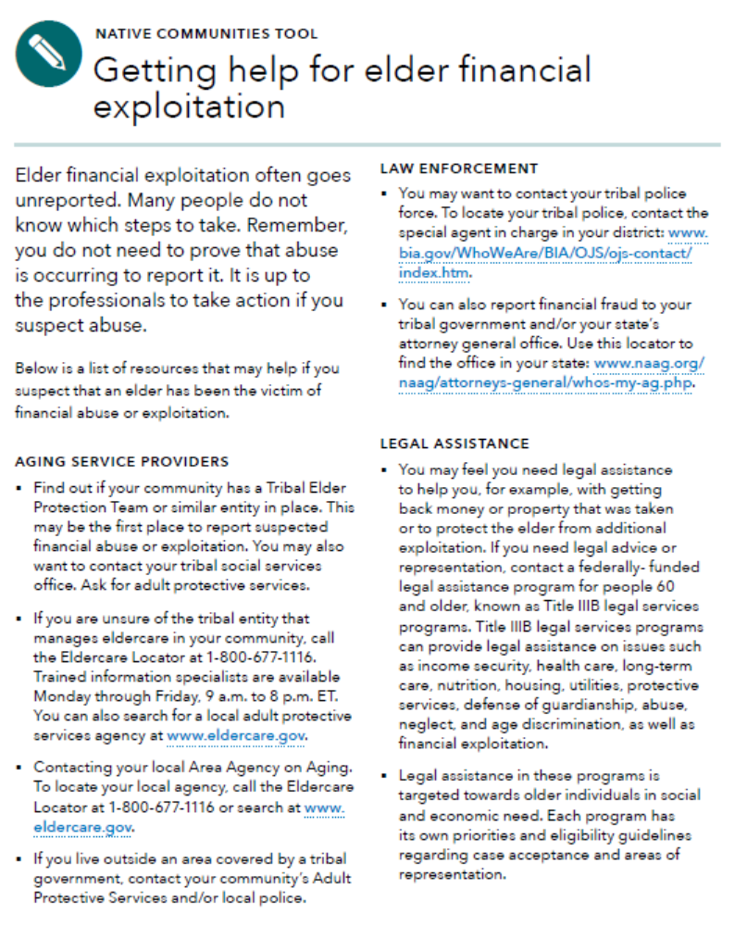
Getting help for elder financial exploitation
This is a list of resources that may help if you suspect that an elder has been the victim of financial abuse or exploitation.
Notes:
Activity #4: Financial Empowerment and Elders CONTINUED
Presentation
Briefly cover “Getting help for elder financial exploitation”.

Slide 69
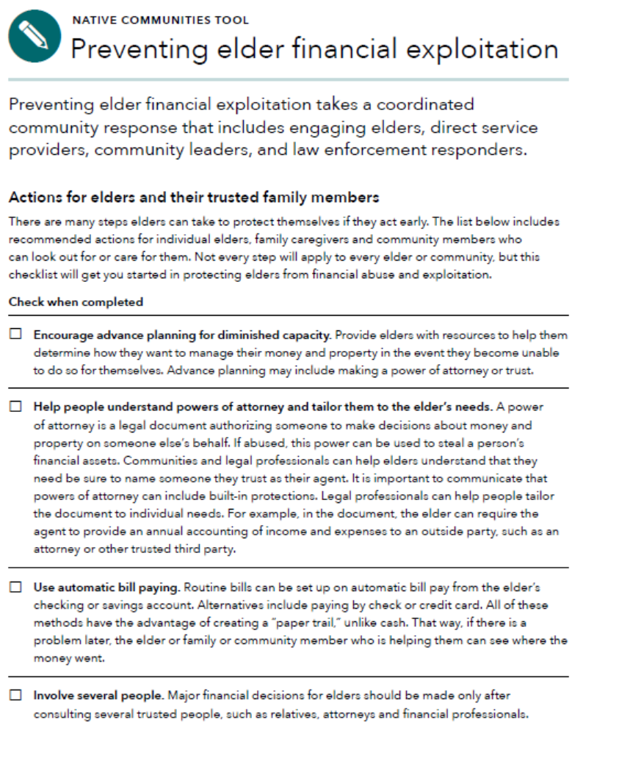
Preventing elder financial exploitation
Preventing elder financial exploitation takes a coordinated community response.
Use this tool to start engaging community members in protecting elders.
The tool contains both strategies for communities to use and actions for elders and their trusted family members to take.
Notes:
Activity #4: Financial Empowerment and Elders CONTINUED
Presentation
The final tool, “Preventing elder financial exploitation,” is about creating a culture that prevents exploiting elders’ finances. This tool includes strategies for communities as well as families.

Slide 70
Closing

Slide 71
Closing
Visit http://www.consumerfinance.gov/educational-resources/your-money-your-goals to
Download Focus on Native Communities
Order and download the Your Money, Your Goals toolkit and other materials
Sign up to receive Your Money, Your Goals email updates
Let us know what you think!
Let us know how you use Focus on Native Communities with the people that you serve
News of your successes and constructive feedback helps the CFPB to develop new resources and enhance existing resources
Email YourMoneyYourGoals@cfpb.gov
Notes:
Activity #5: Closing
Estimated Time: 10 Minutes
Methodology: Various methodology
Corresponding Sections: Content Module of Focus on Native Communities starting on page 71
Presentation
Review how to get Focus on Native Communities and how to stay informed about Your Money, Your Goals.

Slide 72
Closing
How do you think you will use this information your community?
OR
What is the most important thing you are taking away from this training?
Notes:
Activity #5: Closing CONTINUED
Closing Circle—Talking Stick
Note—You will need a talking stick or something to stand in for a talking stick for this activity.
Ask participants to get into a circle. If the group is too large, they can stay seated.
Invite each person to share:
How they intent to use this information in their community.
OR
They most important thing they are taking away from the training.
Note—You can make up your own closing statements for participants to respond to.
Each person shares when they have the stick passed to them.
Be sure to remind people that they are welcome to pass—not say anything.
Thank participants for their contributions

Slide 73
Thank you!
Contact us: YourMoneyYourGoals@cfpb.gov
Notes:
Activity #5: Closing CONTINUED

