Slide 1
Community-Based Participatory Research (CBPR): A Grounding for Action and Social Change
Race at the Forefront:
Sharpening a Focus on Race in Applied Research
March 27, 28, 2019
Bonnie Duran DrPH Professor,
University of Washington School Social Work & Public Health
Director, Center for Indigenous Health Research
Indigenous Wellness Research Institute www.iwri.org

Slide 2
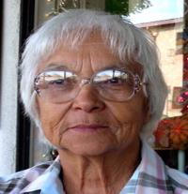
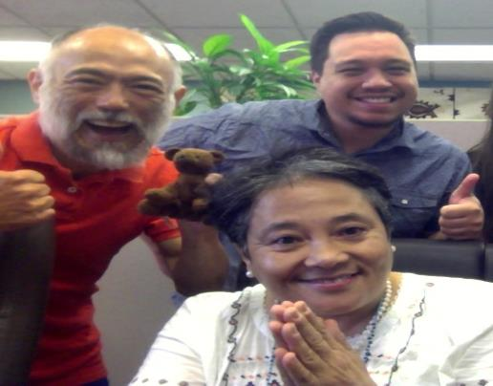
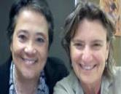
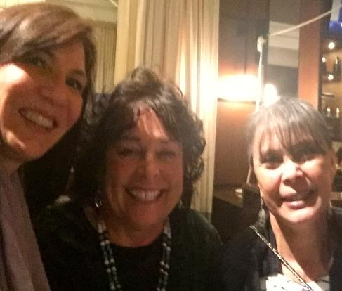
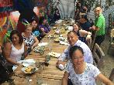
Bonnie’s Social Location
Mixed race Native: Opelousas & Coushatta descendant, 1st gen college student, SFSU, Berkeley
Product of the civil rights and women’s movement
Grew up professionally in urban Indian community clinics, and Tribal communities
CBPR methods/ADM Epidemiology / Interventions in “Indian Country”
Met the Dharma in 1982--Mindfulness Retreat Teacher, Insight Meditation Society, Spirit Rock Meditation Center Teachers Council

Slide 3
Key Ethical Rationale

Slide 4
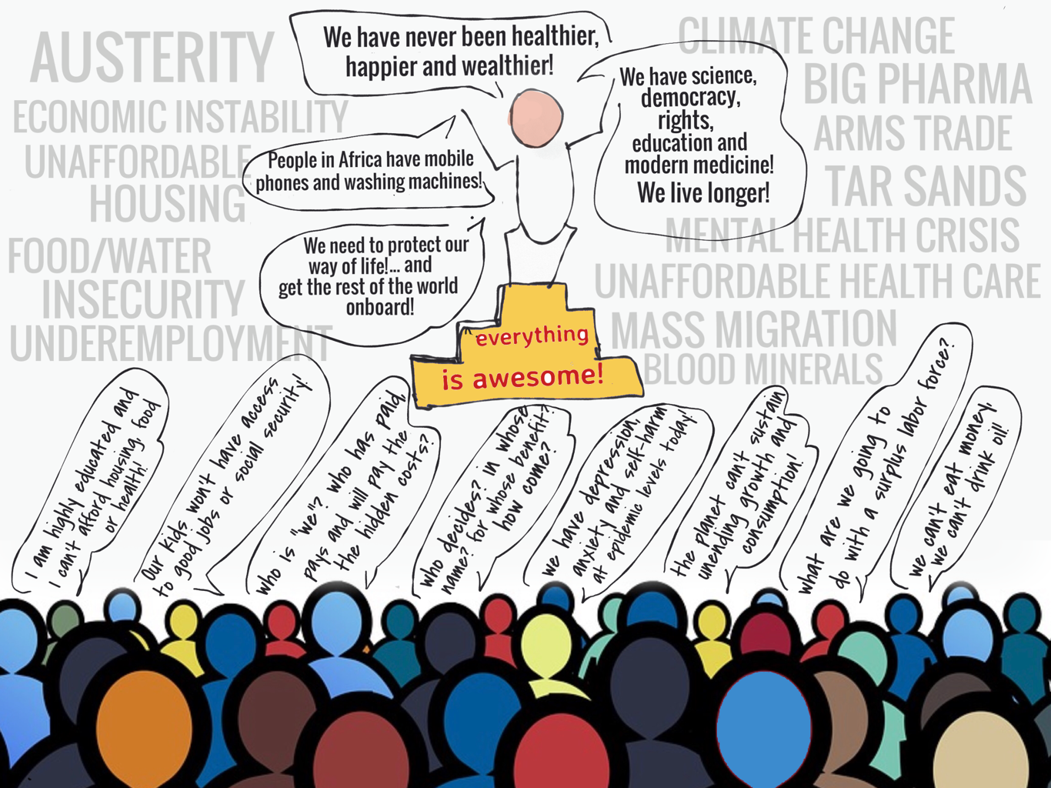
Rationale for Partnership Research
Notes:
Western Culture is the Pinnacol of social evolution

Slide 5
Mistrust of Research
History is written
by people in power
Research
Controlled

Slide 6
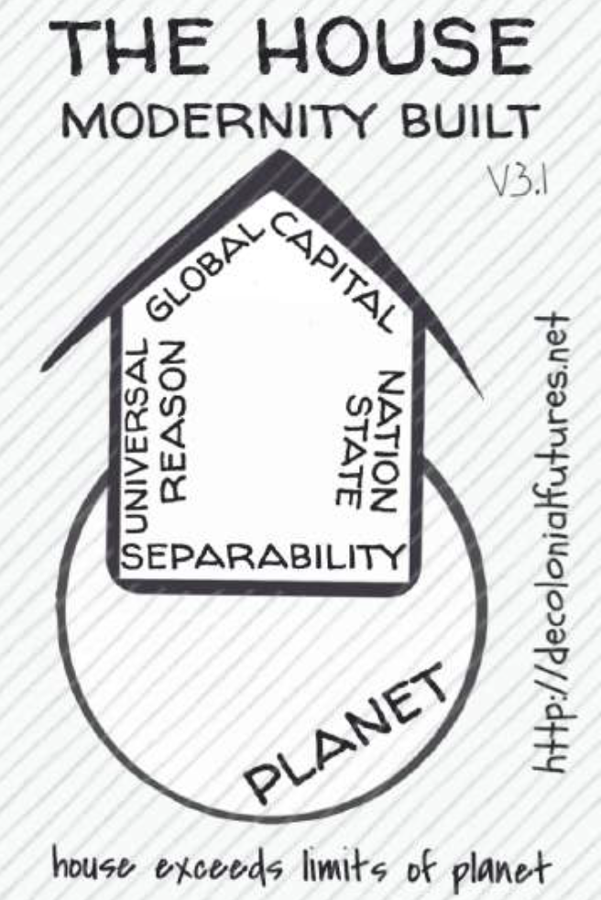
A Western Modernity/Coloniality Episteme
Genealogy: 17th Century No. Europe Reformation thought, Enlightenment, French Revolution crystallized in 18th Century into “Modernity/Coloniality” and consolidated within the Industrial Revolution and motivated, in part, by colonization
Philosophically, emergence of the notion of “Man” as the foundation for all knowledge & order, separate from the natural and the divine ~ teleological action~
Culturally, Lifeworld is subsumed by forms of expert knowledge linked to capital and state administrative apparatuses (Foucault's disciplines)
Sociologically, rise of nation-state institution, knowledges for material reproduction
Indigenous and Subalterns studies scholars in the America’s, India, the Atlantic, Poststructuralists, Critical theorists..
Notes:
In the beginning colonialism was a product of a systematic repression, not only of the specific beliefs, ideas, images, symbols or knowledge that were not useful to global colonial domination, while at the same time the colonizers were expropriating from the colonized their knowledge, specially in mining, agriculture, engineering, as well as their products and work.

Slide 7
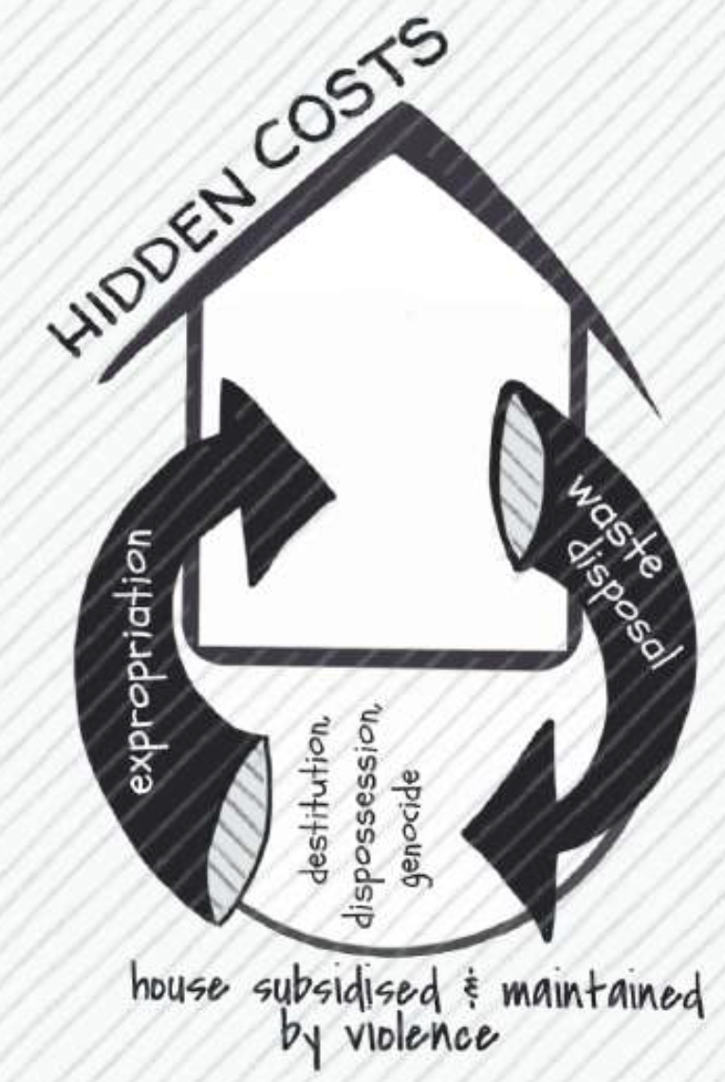
4 Pillars of the Colonial Matrix of Power
Control of Economy- land appropriation, labor exploitation, control of natural resources
Control of Authority-government, normative social institutions, army
Control of Gender and Sexuality- family, education
Control of Subjectivity and Knowledge -epistemology, education and formation of subjectivity
https://decolonialfutures.net
Quijano A. Coloniality and modernity/rationality. Cultural Studies 2007;21(2-3):168-178.
Notes:
Quijano’s seminal article the colonial matrix of power has been described in four interrelated domains:
control of economy (land appropriation, exploitation of labor, control of natural resources);
control of authority (institution, army);
control of gender and sexuality (family, education) and
control of subjectivity and knowledge (epistemology, education and formation of subjectivity).
Furthermore, implanting the colonial matrix of power (either in sixteenth century No America
or in today’s Iraq) implies to dismantle, simultaneously, existing forms of social organization and ways of life.

Slide 8
Epistemicide

Slide 9
Close relationship of “expert knowledge” to political power
McClellan, E. (1873). Obstetric Procedures among the Aborigines of North America. Clinic of the Month, 99-106.

Slide 10
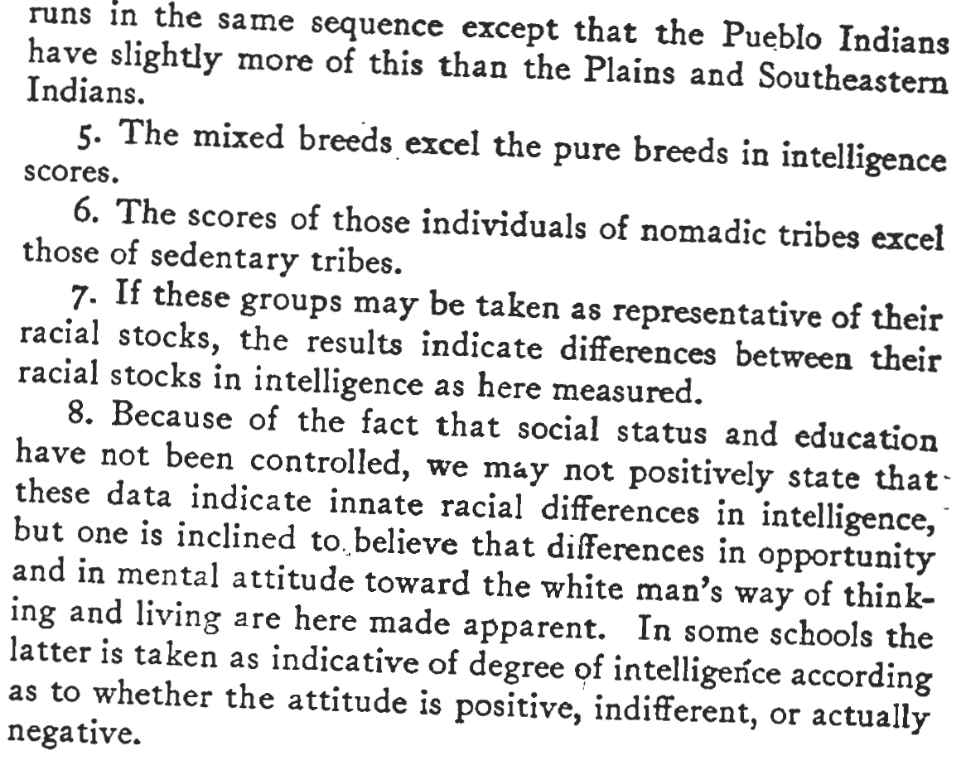
“Scientific” stories about race & skin color
Garth, T. R. (1923). A Comparison of the Intelligence of Mexican and Mixed and Full Blood Indian Children. Psychological Review, 30, 388-401.

Slide 11
Frameworks for Understanding & Addressing Structural Inequality
Settler Colonialism as a historic event and existing system
Epistemicide and Knowledge Democracy
Epistemic Injustice: Testimonial and Hermeneutic
Community-Based Participatory Research
https://engageforequity.org

Slide 12
Settler Colonialism

Slide 13
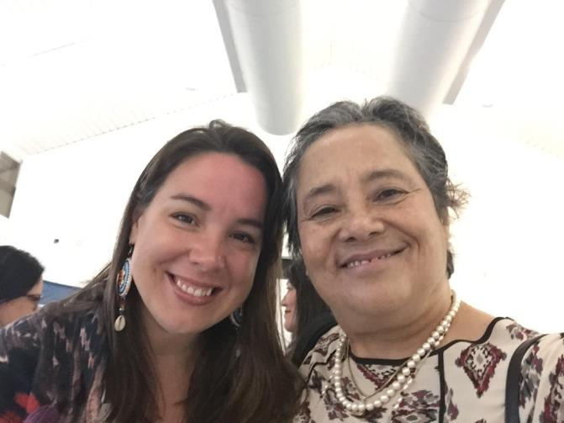
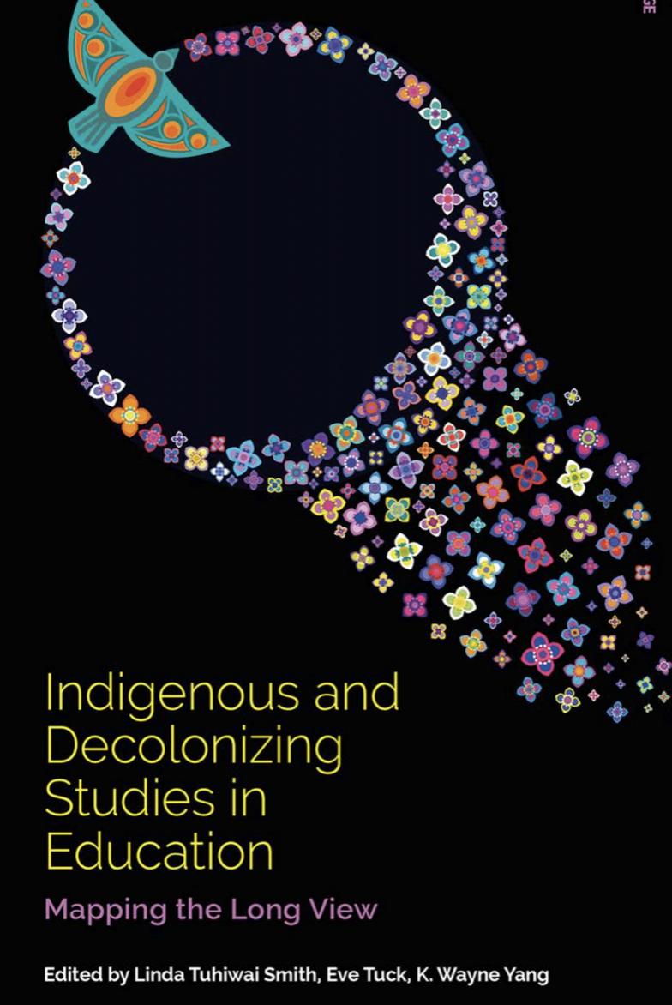
Settler Colonialism
https://goo.gl/kzMHS3
Notes:
2019

Slide 14
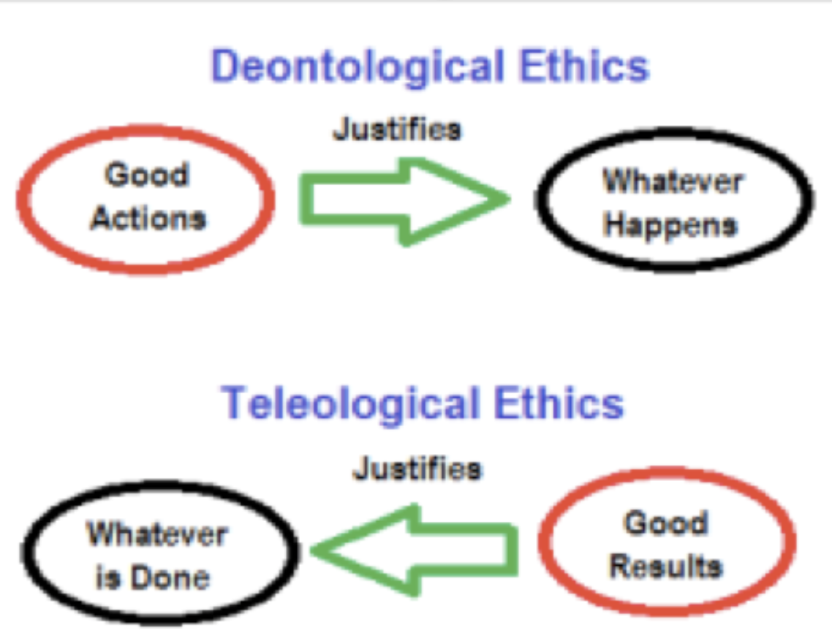
1.”Market-based” solutions are the most stable and sustainable vs “top down” publicly funded services that rely on the “arbitrary” redistribution of wealth and resources.
2. The Market is the ultimate arbiter of an individual’s worth and it allocates resources based on a “natural” and immutable process that should not be questioned, perverted or impeded by Government.
3. Because the Market is an impartial and efficient distributor of resources, wealth and income inequality is actually a moral imperative and the people who accrue more resources deserve their wealth, while the “losers” who have not been able to thrive in the Market environment must simply accept their fate because there is no sustainable alternative to the Market-based system.
Neoliberalism

Slide 15
Viewed from the perspective of the excluded and discriminated against, the historical record of global capitalism, colonialism, and patriarchy is full of institutionalized, harmful lies.
The understanding of the world is much broader than the Western understanding of the world.
There is no global social justice without global cognitive justice.
A crucial epistemological transformation is required to reinvent social emancipation on a global scale.
Notes:
KNOWLEDGES DEMOCRACY Colonialism is a system of naturalizing differences in such a way that the hierarchies that justify domination, oppression, and so on are considered the product of the inferiority of certain peoples and not the cause of their so-called inferiority. Their inferiority is ‘natural’, and because it is natural, they ‘have’ to be treated accordingly; that is, they have to be dominated. Historically, colonialism also means invasion and foreign occupation. This foreign occupation is very important because it is a negation of all conceptions of territoriality: meaning states, political organizations, and cultures that existed within the occupied territories prior to their colonial occupation.

Slide 16
Epistemic Injustice
Testimonial Injustice: a reduction in the credibility of a speaker due to prejudice in the hearer
Hermeneutical Injustice: a reduction in the intelligibility of the experience of a person who is a member of a marginalized group, either to herself or to others, due to a lack of hermeneutical resources in the community
e.g. Sexual Harassment

Slide 17
Freire Reflection/Action Praxis: Tools to Strengthen Partnerships
Listening
Listening
Listening
Dialogue
Dialogue
Dialogue
Action
Action
Action
Notes:
This is the theory but what does it look like in practice....
It is important to recognize that this is a process. Initial listening and dialogue state, and then third stage is action resulting from the problem posing….it is a current spiral of action-reflection-action
Learning from the process
Changes are not immediate…..recognize complexity and time needed for solutions with individuals and communities
Slow nurturing process with people exploring visitons as they work on problems
Listen: investagate the issues or generative themes of the community
Dialogue: Promote critical discussion through various strategies including code or triggers
Action: Strategizing the change students ienvirion about their frefleciton
1.

Slide 18
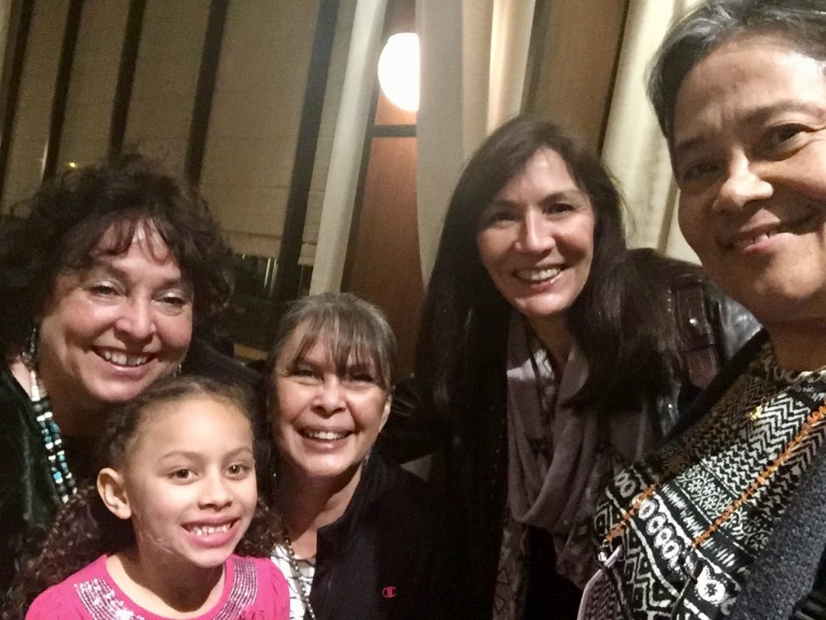
Current Research Context
NIDA: Drug & Alcohol Policy & Organizational Determinants (N=112 students & N=222 faculty & staff)
NIMHD: Psychiatric Epidemiology (N = 3,202)
NIAAA: Alcohol Harm Reduction Intervention Study (N = 977)

Slide 19
TCU System– 36 US Colleges & 1 in Canada
37 TCU
85 Sites
16 States
16,629 Native & other students

Slide 20
Multi-Year NIH-funding to Develop Science & Policy of CBPR
Stage 1: CBPR Conceptual Model
2006-2009 NIMHD Funding
(Led by Nina Wallerstein, Bonnie Duran UNM)
Stage 2: Surveys / Case Studies
2009-2013 Research for Improved Health
(co-led by NCAI, Bonnie Duran, Nina Wallerstein)
Stage 3: New Measures & Tools
2015-2020 Engage for Equity (E2)
(Led by Nina Wallerstein John Oetzel Bonnie Duran)

Slide 21
CBPR Model
Context
Partnership
Intervention
(Programs)/Research
Health/
Social Justice Outcomes
Notes:
This model was therefore created to facilitate CBPR partnerships ability to put their partnership in a framework that supports ongoing collective reflection and evaluation for strengthening the quality and effectiveness of their partnership to reach desired outcomes

Slide 22
Context
Social-Economic Status, Place, History, Environment, Community Safety, Institutional Racism, Culture, Role of Education and Research Institutions
Social
& Structural
Political
&
Policy
National/ Local Governance/Approvals of Research; Policy & Funding Trends
Health
Issue Importance
Perceived Severity by Partners
Capacity
&
Readiness
Collaboration
Trust &
Mistrust
Community/Academic, History of Organizing
Partnership Capacity
Historic Trust / Mistrust between Partners

Slide 23
Relational Partnership Processes
How we interact
Safety
Respect/Trust
Community Voice / Influence
Flexibility
Dialogue & Listening/ Mutual Learning
Conflict Management
Leadership
Power Shared/ Stewardship
Collective Reflection/ Reflexivity
Participatory Decision- making
Task Roles Recognized
Individual Characteristics
Relationships
Partnership Structures
CBOs
Agency
Community
Funders
Academic
Government
Health Care

Slide 24
Structural Partnership Processes
Diversity: Who is involved
Complexity
Resource Management
% Dollars to Community
CBPR Principles
Individual Characteristics
Relationships
Formal Agreements
Partnership Values
Bridging Social Capital
Time in Partnership
Partnership Structures
CBOs
Agency
Community
Funders
Academic
Government
Health Care

Slide 25
Intervention and Research
Processes
Outputs
Processes that honor cultural knowledge and community voice, fit local settings, and use both academic & community language lead to Culture-Centered Interventions
Integrate Cultural Knowledge
Culture-Centered Interventions
Empowering Co-Learning Processes lead to Partnership Synergy
Empowering Processes
Partnership Synergy
Community Members Involved in Research leads to Research/Evaluation Design that Reflects Community Priorities
Community Involved in Research
Appropriate Research Design
Multi-directional Translation, Implementation & Dissemination

Slide 26
Outcomes
Intermediate
University & Community Environments
Policy Environment
Sustained Partnership
Empowerment
Shared Power Relations in Research
Cultural Reinforcement
Individual Partner / Agency Capacities
Research Productivity
Sustained Partnership & Projects
Individual, Organizational, Community
Stronger Community Voice in Research/ Knowledge Democracy
Growth in Skills and Capacities
Research Outcome, Papers, Grant Applications & Awards
Long-term
Future Policies / Social Transformation/
Research Meeting Community Needs
Community/Transformation
Social Justice
Health / Health Equity
Health Behaviors and Health Status Changes

Slide 28
Key Findings: (RIH) Promising Practices from 200 federally-funded community engaged/CBPR Projects
Partnership Capacity: Project has what it needs to work effectively towards its aims
Shared CBPR Principles and Values: Equitable partnerships builds on strengths of partners
Community Involved in all Stages of Research: (CERI index)
Influence: Partners believe they have impact on the partnership
Leadership: Perception of PI skills
Resource Management: Appropriate use of financial & in-kind resources
Written Agreement: Formal agreements helpful
Control of Resources: Shared control and “mostly community” best
Bridging Social Capital: Capacity of academic team to connect with community
Cultural Centeredness: influence/Community Voice (CERI Index); participatory decision-making; [E2: added reflexivity; community fit; CBPR principles]

Slide 29
Tools from Engage for Equity
River of Life/Historical Timeline
Visioning with the CBPR Model
Partnership Data Report
Promising Practices Guide
Claiming Your Principles
engageforequity.org

Slide 30
Step 1: Claiming Your Principles
Identifying shared core values and principles is key to building trust and synergy in a partnership. We provide an exercise to help you identify the personal values you each bring to research partnerships, your shared values, and then provide literature on ]classic CBPR principles that allows you to compare your own values.

Slide 31
Step 2: Creating your Partnership River of Life
The River of Life is a reflective tool that helps you describe the history of your partnership or engaged-research project, and how this life journey has shaped where your partnership is now. With this tool you will reflect on:
History and influences that motivate partners to work together.
The goals, processes, and results of your partnerships’ work.

Slide 32
Step 3: Visioning with the CBPR Model
The Workbook Guide explains how to use the Model as a visioning tool to identify your own outcomes and the partnering practices you are using to get there. The Guide explains how to:
• Adapt the Model to your own circumstances and community context
• Use the Model to plan a new research project
• Evaluate your existing partnership practices
• Assess the impact of your practices on your desired outcomes.

Slide 33
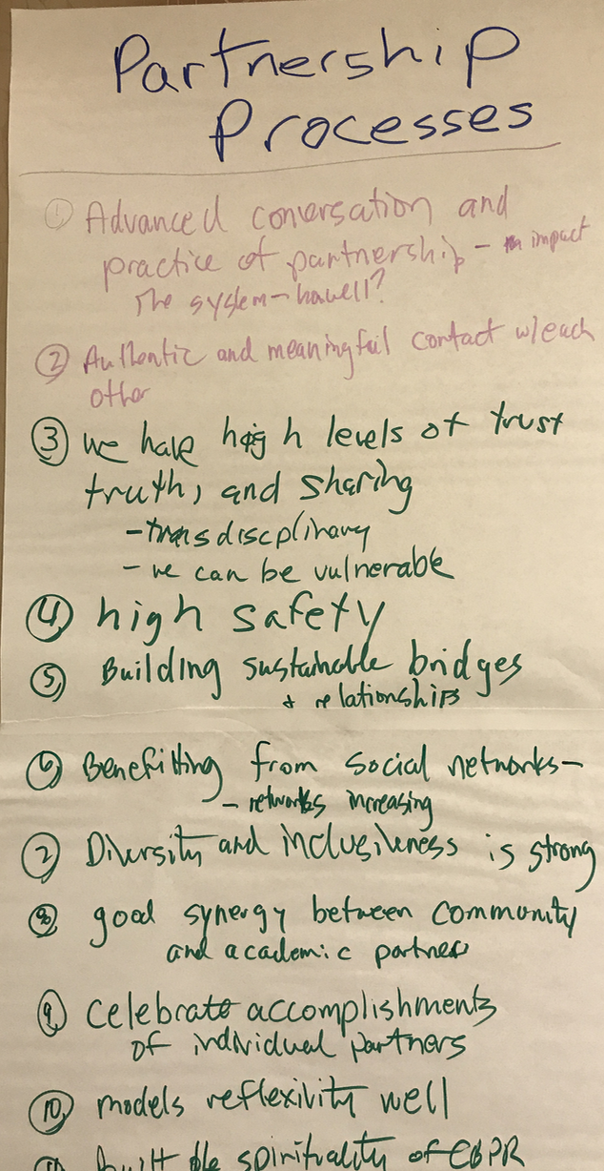
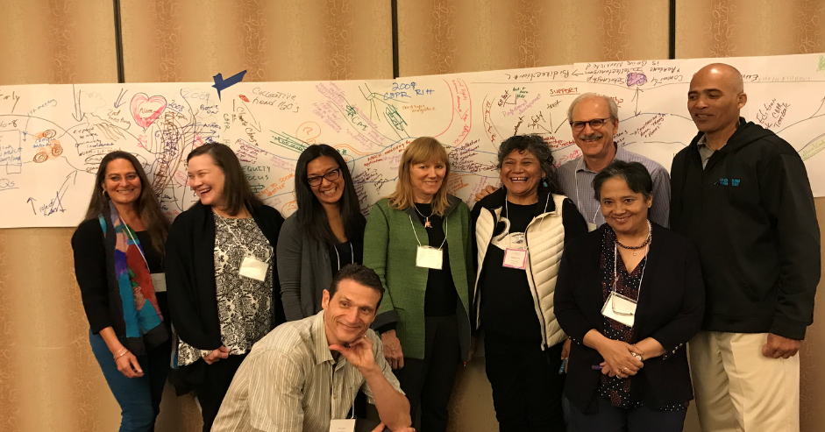

Slide 34
Step 4: Using Promising Practices Guide

Slide 35
Data Tools to Trigger Reflection and Dialogue

Slide 36
Notes:
Cronbach’s alpha

Slide 37
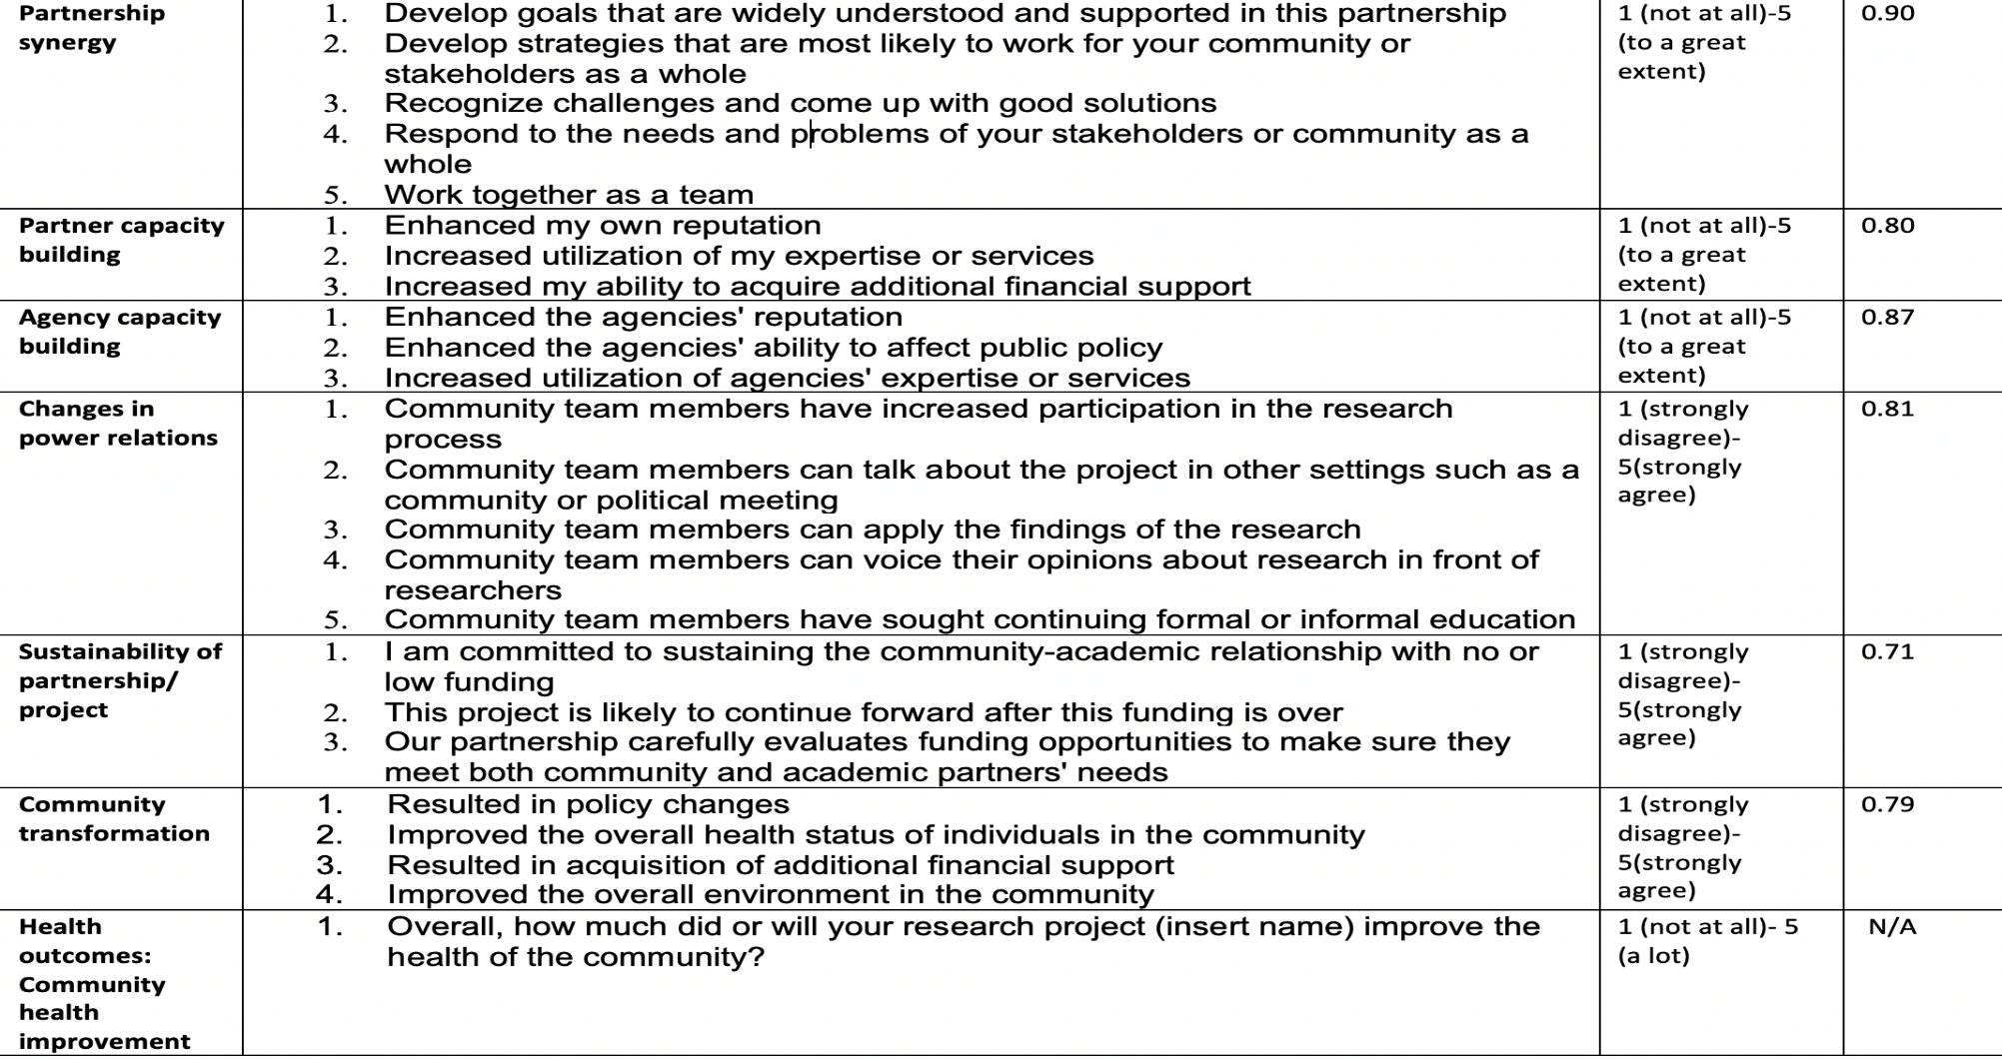

Slide 38
Starting with ourselves
1. How do we ‘decolonize’, ‘deracialize’, ‘demasculanize’ and ‘degender’ our inherited ‘intellectual spaces’?
2. How can we start to heal our individual and collective pain without guilt, paralysis, self-righteousness, entitlement, depoliticization, wound-attachment, transference, tantrums, re-wounding and drama?
4. How can we hospice a dying way of knowing/being and assist with the birth of something new, still fragile, undefined and potentially (but not necessarily) wiser with radical tenderness? https://decolonialfutures.net

Slide 39
My tips…
https://goo.gl/xU5dqH

Slide 40
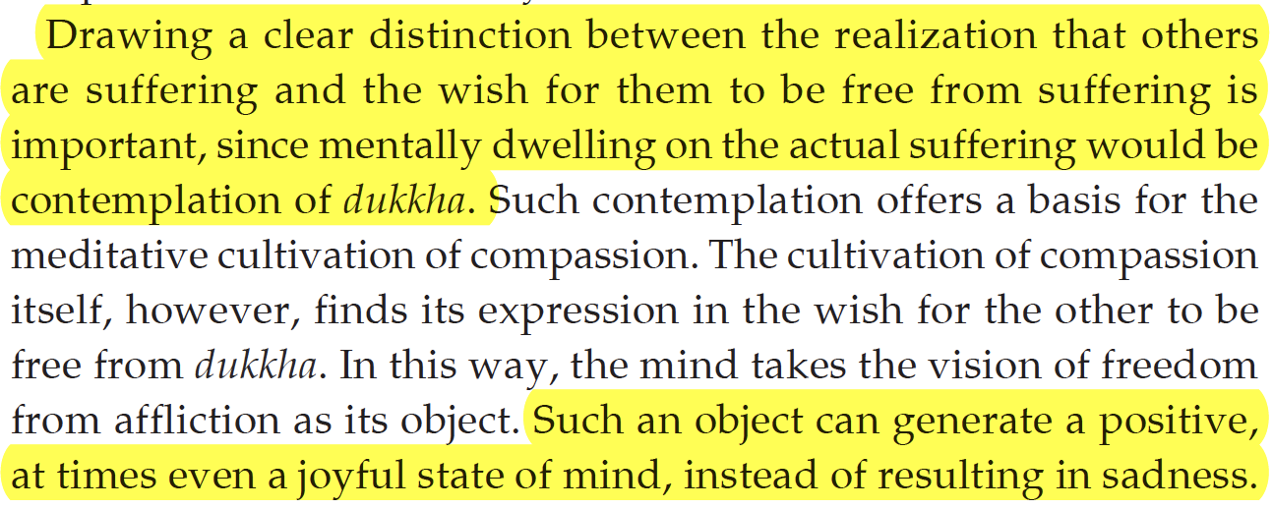
Safety: Self-Compassion
When working with others who are suffering, focus on your own wish for there wellbeing, and happiness.
Don’t need to focus on their state-of-mind
Focus on your wishes for their happiness and safety

Slide 41
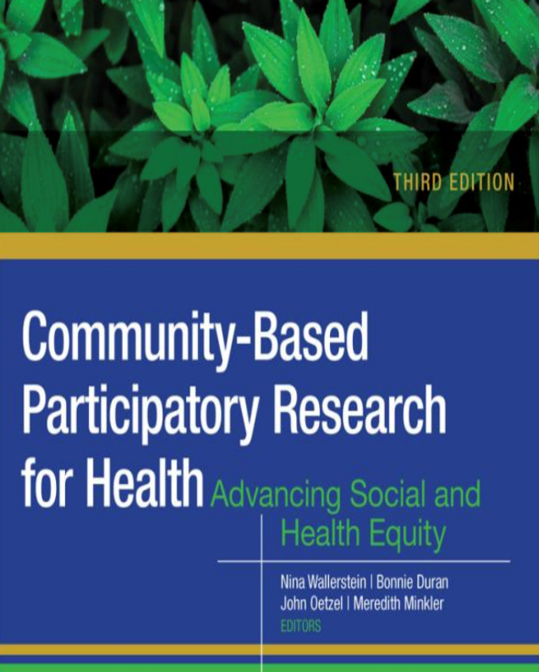
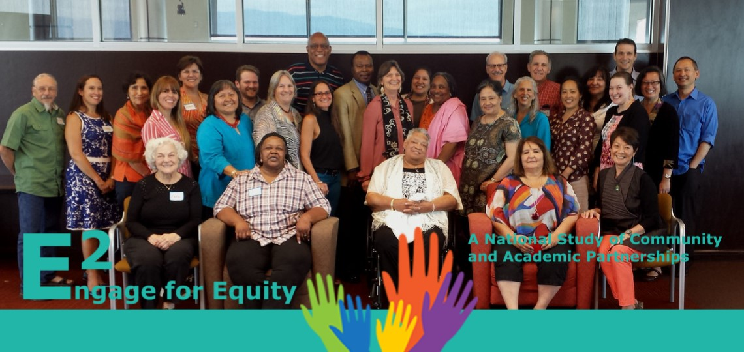
Acknowledgements to Partners
Engageforequity.org

