Slide 1
Race, Policy, & Social Mobility
Bradley L. Hardy
American University
Race at the Forefront in Social and Economic Policy
CRISMA Inaugural Conference

Slide 2
Differences in social & economic mobility across the U.S.
role of “place” as a determinant of socioeconomic outcomes in America
intergenerational social mobility
transmission of economic status across generations
broad concern surrounding opportunity
a land of opportunity implies:
future success $≠$ f(family background)

Slide 3
Low Parental Income & Adult Child Incomes
Chetty et al. (2018). Opportunity Atlas

Slide 4
What other factors potentially influence these observed outcomes?
Do these contemporary outcomes have structural, historical determinants?
State & local policy choices – current & past
minimum wages, economic development
Race & policy (Hardy, Parman, & Logan 2018)
historical policies & cumulative impacts
exclusion: housing, education, social welfare, & criminal justice policies

Slide 5
State Labor Market Policy Differences
2018 State Minimum Wages (DOL)
2017 State EITC (CBPP)

Slide 6
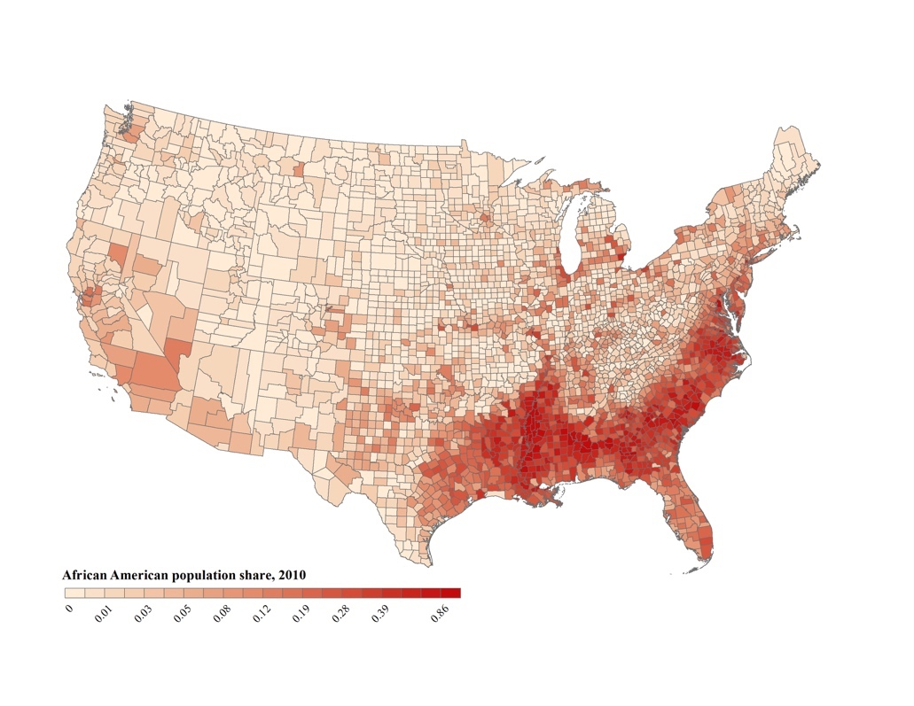
Distribution of the black population in the United States, 2010 (U.S. Census Bureau)
Hardy et al. (2018)

Slide 7
Historical Factors? Persistent Poverty
Islam, Minier, & Ziliak (2015)

Slide 8
Longer-term historical factors?
Features associated with historical racial segregation may represent important, understudied factors
Inequity in local-level policies, opportunities?
Differences in local attitudes & institutions?

Slide 9
The role of historical racial segregation
Relatively new developments in digitization, geocoding facilitate examination
Logan & Parman (2017): segregation was high in southern, urban areas; increased dramatically over 1800s to 1940
Explore linkages between historical segregation & contemporary social mobility
w/ R. Andrews, M. Casey, & T. Logan

Slide 10
Logan & Parman (2017)

Slide 11
Logan & Parman (2017)

Slide 12
Mobility & segregation
Historical racial segregation may
proxy for attitudes, social codes (Acharya et al. 2016; Dell 2010)
limit economic progress of disadvantaged groups
Historical segregation + related measures may be omitted factors
Including such measures could add to understanding of how economic status is transmitted

Slide 13
Location Matters (Andrews et al. 2017)
We find that higher local historical segregation is associated with lowered intergenerational social mobility
Institutional features & racial policies of late 19th, early 20th century could shape current-day inequality
Suggests inequality is more deeply entrenched than generally discussed
more robust policies to mitigate these gaps

Slide 14
Mechanisms impacting social mobility
Our work + other recent work (e.g. Rothbaum 2016; Islam et al. 2015) considers the role of sorting, historical factors as drivers of mobility & inequality
Future work (w/ M. Casey): how do ”contemporary” neighborhood economic conditions during childhood shape adult social mobility outcomes?
By neighborhood type
By race

Slide 15
Discussion & Conclusion
What role do historical factors – attitudes and investments – play in observed mobility outcomes today?
How do contemporary neighborhood dynamics during childhood shape social mobility outcomes?
We need to understand & discuss mechanisms
do local attitudes shape investments?
investments in: education & educational opportunities, labor market opportunities, social safety net, neighborhood conditions
CRISMA has an important role to play here

Slide 16
Thank You
Please share comments & ideas
hardy@american.edu

Slide 17
Appendix Slides

Slide 18
Segregation & neighborhood quality
Broad social science literature on segregation & socioeconomic outcomes
Largely focused on inequality in urban areas
Higher segregation is associated with differences in school quality, services, & neighborhood quality
e.g. Cutler & Glaeser (1997); Wilson (1987); Massey & Denton (1993); Sampson (2012) ; Sharkey (2013)

Slide 19
Neighbor based segregation measure (Logan and Parman 2018)
$$\frac{E\left(\overline{x_{b})}−{(x}_{b}\right)}{E\left(\overline{x_{b}}\right) −E(\underline{x_{b}})}$$
$x_{b}$: number of black hh living next to white neighbors
$E(\overline{x_{b}})$: expected number under random assignment
$E(\underline{x_{b}})$: expected number under complete segregation

Slide 20
Dissimilarity Index
$$D=\frac{1}{2} \sum_{i}{|\frac{b_{i}}{b}−\frac{w_{i}}{w}|}$$
$b_{i}:$ black hh in geographic unit i (e.g. tract); $b:$ total blacks in city
$w_{i}:$ white hh in geographic unit i; w: total whites in city
Measures how evenly blacks are distributed across geographic units within a city

Slide 21
Isolation Index
$$I=\sum_{i}{(\frac{b_{i}}{b}∗\frac{b_{i}}{b_{i}+w_{i}})}$$
$b_{i}:$ black hh in geographic unit i (e.g. tract); $b:$ total blacks in city
$w_{i}:$ white hh in geographic unit i
Measures the exposure of the average black resident to white residents

