Slide 2
Financial Capability and Asset Building (FCAB) for All
Margaret Sherraden, PhD
Social Work’s Grand Challenges:
Economic Inequality and Financial Capability
University of Denver, October 25, 2018

Slide 3

The financial struggles of vulnerable families
A worldwide context of rising economic inequality (Alvaredo et al., 2013; Piketty & Saez, 2003)
Household finances are increasingly complex (not cash-based) (Lusardi, Mitchell & Curto 2009; Martin, 2002)
Growing financialization creates barriers for the poor and vulnerable (Mader, 2017; Martin, 2002)
Financially struggling, families feel stressed, ashamed, and uncertain about the future (APA, 2017; Atwood, 2012)

Slide 4
Millions are not just money poor, they are also credit poor
An estimated 45 million people do not have a credit history or have unscoreable credit records (CFPB, 2015a).
Higher rates for Blacks and Hispanics, and people in poor neighborhoods.
They cannot obtain loans at reasonable rates
They also have difficulty simply surviving. They are, for example:
Turned down for jobs
Have trouble renting an apartment
Are ineligible for cellphone contracts
They are both money poor and credit poor.

Slide 5
Where do the money- and credit-poor turn for help?
Well-to-do families buy financial and legal advice
They benefit from job benefits and tax policies that build their family’s financial security
Meanwhile, disadvantaged families mostly make do on their own or turn to family and friends
Many fall prey to “late night television” financial and legal advisors, and predatory schemes that promise financial relief
Some get help from a patchwork of organizations, such as:
Consumer credit counseling, financial empowerment centers, community credit unions, and others

Slide 6
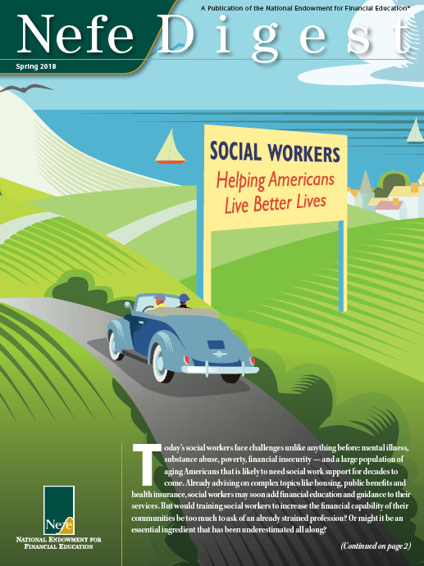
What about social work?
Day in and day out, human service organizations and their staff deliver support and services to financially vulnerable populations
In Progressive Era, social workers addressed household finances
But today, FCAB is not covered in social work curriculum (Gates et al., 2016; Sherraden et al., 2018)
Why not again?
(Nefe, 2018)

Slide 7
Financial capability:*
Ability and opportunity to act
Financial Capability
Ability to Act
Financial
knowledge & skills
Financial Well-Being
Income, assets, spending, credit, and protection
Opportunity to Act
Financial inclusion
Based on capability theory and person-in-environment perspective
(Kondrat, 2013; Sen, 1999; Nussbaum, 2011)

Slide 8



Improving people’s ability and opportunity to act
Macro Practice
Micro Practice
Develop and advocate for inclusive and progressive programs and policies for:
  Income support (Lein et al., 2015)
  Financial services (Friedline, Despard & West, 2017)
  Asset building (Sherraden, et al, 2018)
  Employment/business development (Sherraden & Sanders, 2010)
Financial counseling/education (Zhan et al., 2006)
Work with clients and communities to improve financial well-being:
Teach financial management (Lusardi et al., 2010)
Assess client financial condition (Scanlon & Sanders 2017)
Set and meet goals
Create spending plans
Resolve financial problems and conflicts (Klontz, Britt & Archuleta, 2015; Nelson et al., 2015)
Enable asset accumulation

Slide 9
Develop a financial capability delivery system that reaches everyone
Embed financial capability services in human service organizations and practices that already exist (e.g., the Change Machine)
Integrate FCAB into human services: Financial assessment alongside health and psychological assessments
Financial education, financial accounts, and savings accounts for everyone
A financial capability gateway

Slide 10
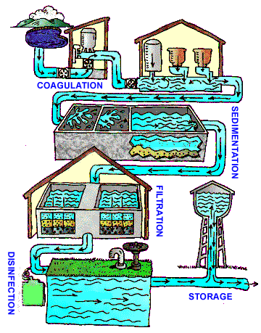
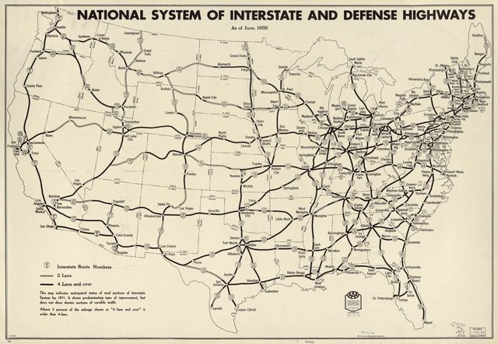
FCAB vision: Basic finance can become a “public good”
Basic financial services could become a public utility, efficient and safe for all, but with fees (e.g., municipal water system)
Or it could become like a pure public good, with no fees other than general taxation (e.g., public highways)

Slide 11
FCAB: A unique opportunity for social work
Social workers can take leadership in developing approaches, developing collaborations, and delivering services to help the financially vulnerable gain a secure economic foothold
In this way, social workers can build on their historical commitment to improving people’s financial well-being (Stuart, 2013)
While social workers show interest, they lack preparation (Despard & Chowa, 2010; Fenge, 2012; Gillen & Loeffler 2012; Kindle, 2013; Loke et al., 2013)
To take up this opportunity, social workers must take up the challenge . . .

Slide 12
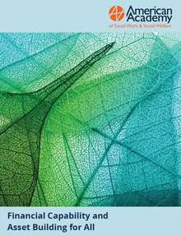
Financial Capability and Asset Building for All
A Grand Challenge for Social Work
http://aaswsw.org/grand-challenges-initiative/
Notes:
Our vision:
FCAB is integrated into foundation social work practice
Social work is an essential part of improving financial well being in disadvantaged families
Social workers speak up on behalf of financially vulnerable populations in this era of financialization
American Academy of Social Work and Social Welfare

Slide 13
FCAB Grand Challenge Efforts
A Sampling
Education and Practice:
FCAB continuing education for social work (Frey, et al., 2017)
Webinars for social work faculty and practitioners (DeVaan, et al., 2017, 2018; Sherraden et al., 2018)
FCAB Community Outreach Center and Field Education Supervisor Training (Elizabeth State College & University)
On the Rise Financial Center (Clark-Atlanta University)
Research:
Survey of student perspectives on FCAB (Birkenmaier et al., 2016; Loke et al., 2017)
Surveys of faculty perspectives on FCAB (Gates et al., 2016; Sherraden et al., 2018)
Mapping financial services (Friedline, Despard & West, 2017)
Education:
CSWE curricular guide for economic well-being practice (CSWE, 2017)
FCAB curriculum (Doran & Bagdasaryan, 2018; Horwitz & Briar-Lawson, 2017; Sherraden, et al., 2017)
FCAB textbook (Sherraden, Birkenmaier, & Collins, 2018)

Slide 14
FCAB for All: Going Global
China
CSD’s Jin Huang, Li Zou and others are working with colleagues in China to introduce FCAB in social work
Article on the U.S. FCAB Grand Challenge published in China Social Work Magazine 中国社会工作杂志 (Huang, et al., 2018)
Disseminated to 300,000 in China

Slide 15
FCAB Training: Going Global
Singapore
Project of the Next Age Institute (NAI)
Collaboration between Washington University in St. Louis and the National University of Singapore (NUS)
Focus groups with practitioners; Interviews with administrators (2017)
Adapt FCAB curriculum to Singapore context and go online (2018-19)
Pilot curriculum with social work undergraduate students (2018)
Train practitioners to disseminate (2018-19)
Integrate FCAB in continuing education (2019)

Slide 16
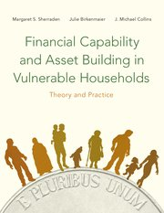
Thank You!
To join the FCAB Grand Challenge or for more information:
FCAB Initiative
Center for Social Development
Brown School of Social Work
Washington University in St. Louis
http://csd.wustl.edu/Pages/default.aspx
+1.314.935.7433
Gena G McClendon: ggunn@wustl.edu
Margaret Sherraden: msherraden@wustl.edu
Oxford University Press
2018
Notes:
You’re invited to join the FCAB Grand Challenge!

Slide 17
References
Addams, J. (1912, c. 1910). Twenty Years at Hull-House with Autobiographical Notes. New York: The MacMillan Company. http://digital.library.upenn.edu/women/addams/hullhouse/hullhouse.html
Alvaredo, F., Atkinson, A. B., Piketty, T., & Saez, E. (2013). The top 1 percent in international and historical perspective. The Journal of Economic Perspectives, 27(3), 3–20.
American Psychological Association (2017). Stress in America: The State of Our Nation. https://www.apa.org/news/press/releases/stress/2017/state-nation.pdf
Atwood, J. D. (2012). Couples and money: The last taboo. The American Journal of Family Therapy, 40 (1),1-19, DOI: 10.1080/01926187.2011.600674
Birkenmaier, J. M., Loke, V., & Hageman, S. A. (2016). Are graduating students ready for financial aspects of social work practice? Journal of Teaching in Social Work, 36(5), 519-536.
Collins, J. M., & O’Rourke, C. (2009). Financial education and counseling: Still holding promise. Journal of Consumer Affairs, 44(3), 483–498.
Consumer Financial Protection Bureau (2015a). Data Point: Credit Invisible. Washington, DC: CFPB. https://files.consumerfinance.gov/f/201505_cfpb_data-point-credit-invisibles.pdf
Consumer Financial Protection Bureau. (2015b). Measuring financial well-being: A guide to using the CFPB Financial Well-Being Scale. Retrieved from http://files.consumerfinance.gov/f/201512_cfpb_financial-well-being-user-guide-scale.pdf
Council on Social Work Education (2017). Curricular guide for economic well-being practice. Washington, DC: CSWE https://www.cswe.org/CMSPages/GetFile.aspx?guid=77de3a0d-8f9d-45e5-b48e-7a57f241945f

Slide 18
References (continued)
Despard, M. R., & Chowa, G. A. (2010). Social workers’ Interest in building individuals’ financial capabilities. Journal of Financial Therapy, 1 (1) 8. https://doi.org/10.4148/jft.v1i1.257
Fenge, L. (2012). Economic well-being and ageing: The need for financial education for social workers. Social Work Education, 31(4) 498.
DeVaan, D., Sherraden, M.S., & McClendon, G.G., “Household Finances in Social Work: Tools for Educators.” Webinar, Center for Social Development, in collaboration with the Consumer Financial Protection Bureau and the Council on Social Work Education, April 19 & September 2017. https://csd.wustl.edu/OurWork/FinIncl/FinCap-AccessAbilities/Pages/FCABEducationalTools.aspx
Doran, J. K., & Bagdasaryan, S. (2018). Infusing financial capability and asset building content into a community organizing class. Journal of Social Work Education, 54(1), 122-134.
Frey, J. J., Hopkins, K., Osteen, P., Callahan, C., Hageman, S., & Ko, J. (2017). Training social workers and human service professionals to address the complex financial needs of clients. Journal of Social Work Education, 53(1), 118-131.
Friedline, T., Despard, M., & West, S. (2017). Navigating day-to-day finances: A geographic investigation of brick-and-mortar financial services and individuals’ financial health. Lawrence, KS: University of Kansas, Center on Assets, Education, & Inclusion (AEDI).
Gates, L. B., Koza, J., & Akabas, S. H. (2016). Social work’s response to poverty: From benefits dependence to economic self-sufficiency, Journal of Social Work Education, 53:1, 99-17. DOI: 10.1080/10437797.2016.1212752.

Slide 19
References (continued)
Gillen, M., & Loeffler, D. N. (2012). Financial literacy and social work students: Knowledge is power. Journal of Financial Therapy, 3 (2) 4. https://doi.org/10.4148/jft.v3i2.1692
Horwitz, S., & Briar-Lawson, K. (2017). A multi-university economic capability-building collaboration. Journal of Social Work Education, 53(1), 149-158.
Huang, J., Sherraden, M. S., & Zou, L. (2018, October). 【视野】普惠金融与金融能力：美国社会工作的大挑战 [From financial inclusion to financial capability: A grand challenge of social work in the United States]. China Social Work Magazine. https://mp.weixin.qq.com/s/z15GHMa00dxgokSiX2TU9A
Kindle, P. A. (2013). The financial literacy of social work students. Journal of Social Work Education, 49(3), 397-407.
Klontz, B. T., Britt, S. L., & Archuleta, K. (2015). Financial therapy. New York: Springer.
Kondrat, M. E. (2013). Person-in-Environment. Encyclopedia of Social Work. DOI: 10.1093/acrefore/9780199975839.013.285
Lein, L., Romich, J., & Sherraden, M. (2015). Reversing extreme economic inequality (Grand Challenges for Social Work Initiative Working Paper No. 16). Cleveland, OH: American Academy of Social Work and Social Welfare. http://aaswsw.org/wp-content/uploads/2016/01/WP16-with-cover-2.pdf
Loke, V., Birkenmaier, J. M., & Hageman, S. A. (2017). Financial capability and asset building in the curricula: Student perceptions. Journal of Social Work Education, 53 (1), 84–98.
Loke, V., Watts, J. L., & Kakoti, S. A. (2013). Financial capabilities of service providers in the asset-building field. In Birkenmaier, J., Curley, J., & Sherraden, M. (Eds.), Financial Capability and Asset Development: Research, Education, Policy, and Practice (pp. 251-277). New York: Oxford University Press.

Slide 20
References (continued)
Lusardi, A., Clark, R. L., Fox, J., Grable, J., & Taylor, E. (2010). Promising learning strategies, interventions, and delivery methods in financial literacy education: What techniques, venues, tactics, mechanisms, etc., show the most promise to promote and achieve financial well-being? Paper presented at the 2010 National Endowment for Financial Education Colloquium, Denver, CO
Lusardi, A., O. Mitchell, & V. Curto (2009). Financial literacy and financial sophistication among older Americans. NBER Working Paper (15469).
Mader, P. (2017). Contesting financial inclusion. Development and Change 49(2): 1–23. DOI: 10.1111/dech.12368 Martin, R. (2002). Financialization of daily life. Philadelpia: Temple University Press.
National Endowment for Financial Education (NEFE). (2018). Nefe Digest: Social Workers Helping Americans Live Better Lives. Denver, CO: NEFE.
Nelson, R. J., Smith, T. E., Shelton, V. M., & Richards, K. V. (2015). Three interventions for financial therapy: Fostering an examination of financial behaviors and beliefs. Journal of Financial Therapy, 6(1), 33-43.
Nussbaum, M. C. (2011). Creating capabilities: The human development approach. Cambridge, MA: Belknap Press of Harvard University Press.
Piketty, T., & Saez, E. (2003). Income inequality in the United States, 1913–1998. The Quarterly journal of economics, 118(1), 1–41.
Saleebey, D. (1996). The strengths perspective in social work practice: extensions and cautions. Social Work, 41(3):296-305.

Slide 21
References (continued)
Scanlon, E., & Sanders, C. K. (2017). Financial capability and asset building: A transformational practice framework. Advances in Social Work 18 (2), 543-562. DOI: 10.18060/21245
Sen, A. (1993). Capability and well-being. In M. Nussbaum & A. Sen (Eds.), The quality of life (pp. 30-53). New York, NY: Oxford University Press.
Sherraden, M., Clancy, M., Nam, Y., Huang, J., Kim, Y., Beverly, S. G., … Purnell, J. Q. (2018). Universal and progressive Child Development Accounts: A policy innovation to reduce educational disparity. Urban Education, 53(6), 803–833.doi:10.1177/0042085916682573
Sherraden, M. S. (2013). Building blocks of financial capability. In J. M. Birkenmaier, M. S. Sherraden, & J. C. Curley, J. (Eds.) Financial Capability and Asset Building: Research, Education, Policy, and Practice. New York & Oxford: Oxford University Press.
Sherraden, M. S., Birkenmaier, J., McClendon, G., & Rochelle, M. (2017). Financial capability and asset building in social work education: Is it “the Big Piece Missing”? Journal of Social Work Education, 53(1), 132-148.
Sherraden, M. S., Huang, J., Frey, J. J., Birkenmaier, J., Callahan, C., Clancy, M., & Sherraden, M. (2016). Financial Capability and Asset Building for All. Working Paper 13. Grand Challenges Initiative, American Academy of Social Work and Social Welfare.
Stuart, P. H. (2016). Financial capability in early social work practice: Lessons for today. Social Work, 61(4), 297–304. doi:10.1093/sw/sww047
Zhan, M., Anderson, S. G., & Scott, J. (2006). Financial knowledge of the low-income population: Effects of a financial education program. Journal of Sociology & Social Welfare, 33, 53–74.

Slide 22


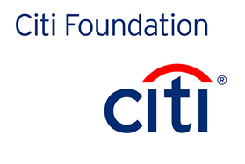
FCAB is an initiative of the Center for Social Development at Washington University in St. Louis, and has received support from:
Wells Fargo
Advisors
Singapore FCAB is a collaboration with the Next Age Institute at the National University of Singapore, and has received funding support from:

